Slide 1





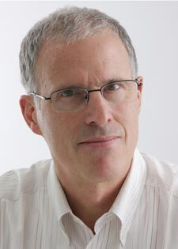
HVAC BEHAVIORAL RESEARCH INITIATIVE
Kristin Heinemeier PhD, Sarah Outcault PhD, Jennifer Kutzleb, Marco Pritoni, Michael Lingenfelter, Alan Meier PhD

Slide 2
Overview
HVAC Behavioral Research Initiative, a few upcoming projects:
The Role of Behavior in Emerging Technologies
The Role of Behavior in ZNE Homes
Field Study of Advanced Thermostats
Where are we going next?
Qualitative Research Methods

Slide 3
THE ROLE OF BEHAVIOR IN EMERGING TECHNOLOGIES

Slide 4


Slide 5
Psychology
Sociology
Physiology
End user
“Middle Men”
Accountability
Competence
Trust/Relationship
User Interface
Comfort Conditions
Technology

Slide 6
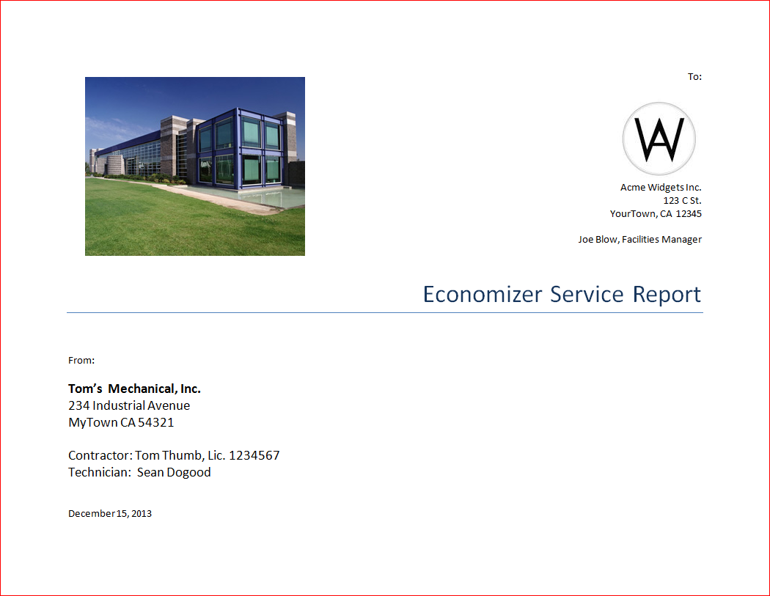
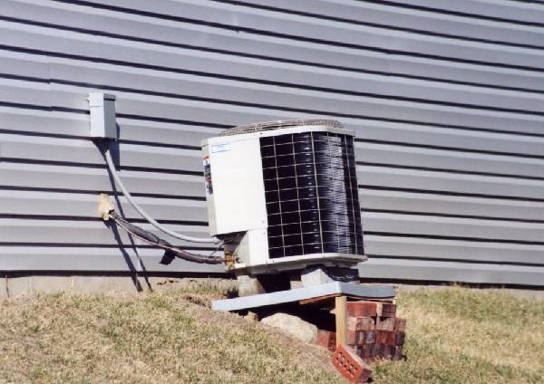
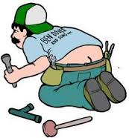
One Barrier: Perceived Value and Technician Sophistication

Slide 7
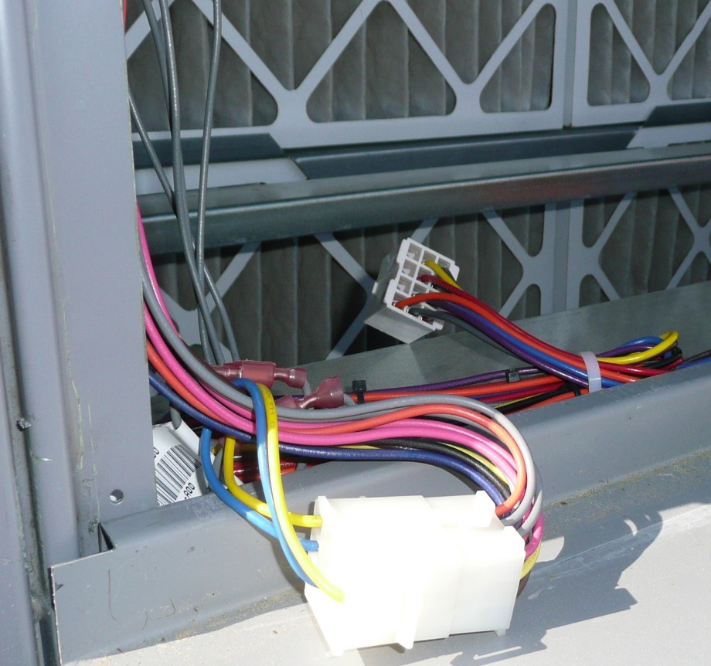
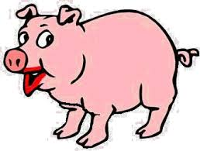
Case in Point: Economizers
Simple idea but very complex technology.
Many techs don’t understand them.
High-limit temperature setting is important, but not well understood.
Not visible and doesn’t affect comfort > not much attention
Easy to disable…up to 40% are disabled right now!
Greater than 60% failures in the field.

Slide 8
Economizers Have a Very High Failure Rate
% Failure | Source | Notes
43% | AEC 2002. | Just damper faults.
50% | Mike Kaplan, Personal Communication with Dave Sellers, 1999. | New construction.
56% | HEC, 1993. | Economizers up to two years old.
64% | Jacobs and Higgins, 2003; and Jacobs et al., 2004. | 124 RTUs 10 tons or less, with economizers.
64% | Jonathan Woolley, Personal Communication, 2013. | 22 RTUs with economizers.
65% | Goody et al. 2003. | Small commercial RTUs.
66% | NEES, 1993. | Units two years old or newer
70% | Davis, et al. 2002. | Small number of RTUs.
70% | KEMA, 2013a | Economizers that had been fixed up to a year ago.
75% | Craig Hofferber, Personal Communication with Dave Sellers, 2000. | Estimate from interviews with consultants, mechanical contractors, and commissioning agents.
80% | Felts and Bailey, 2000. | Existing RTUs
100% | Pratt, et al., 2000. | Four of four RTUs investigated.
Source: Heinemeier, in press, ACEEE 2014

Slide 9
Emerging Technology Studies
Advanced Digital Economizer Controllers
Fault Detection and Diagnostics
Climate Appropriate HVAC Systems

Slide 10
THE ROLE OF BEHAVIOR IN ZNE HOMES

Slide 11
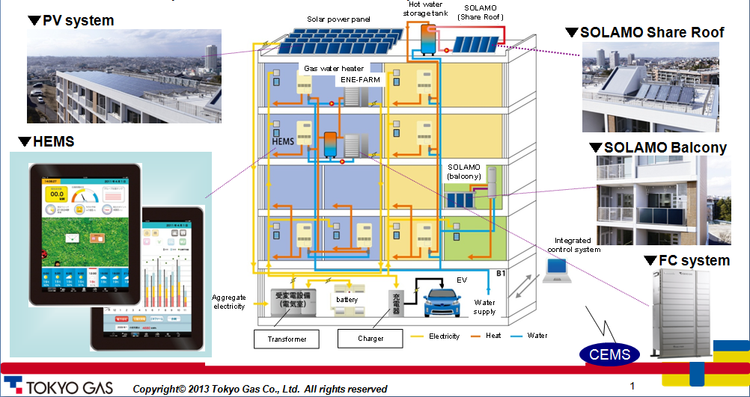
E-Sogo Smart House

Slide 12
Analysis of First Year Performance
Source: Tokyo Gas Company
Energy Efficiency Envelope and Architectural Design
On site energy system
reduction
The primary energy
usage
70%
About 30%reduction
36%

Slide 13
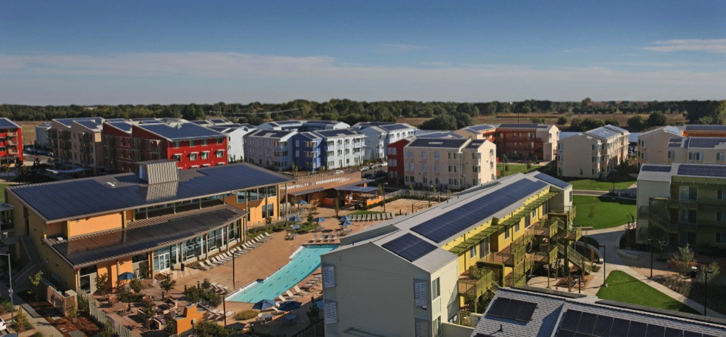
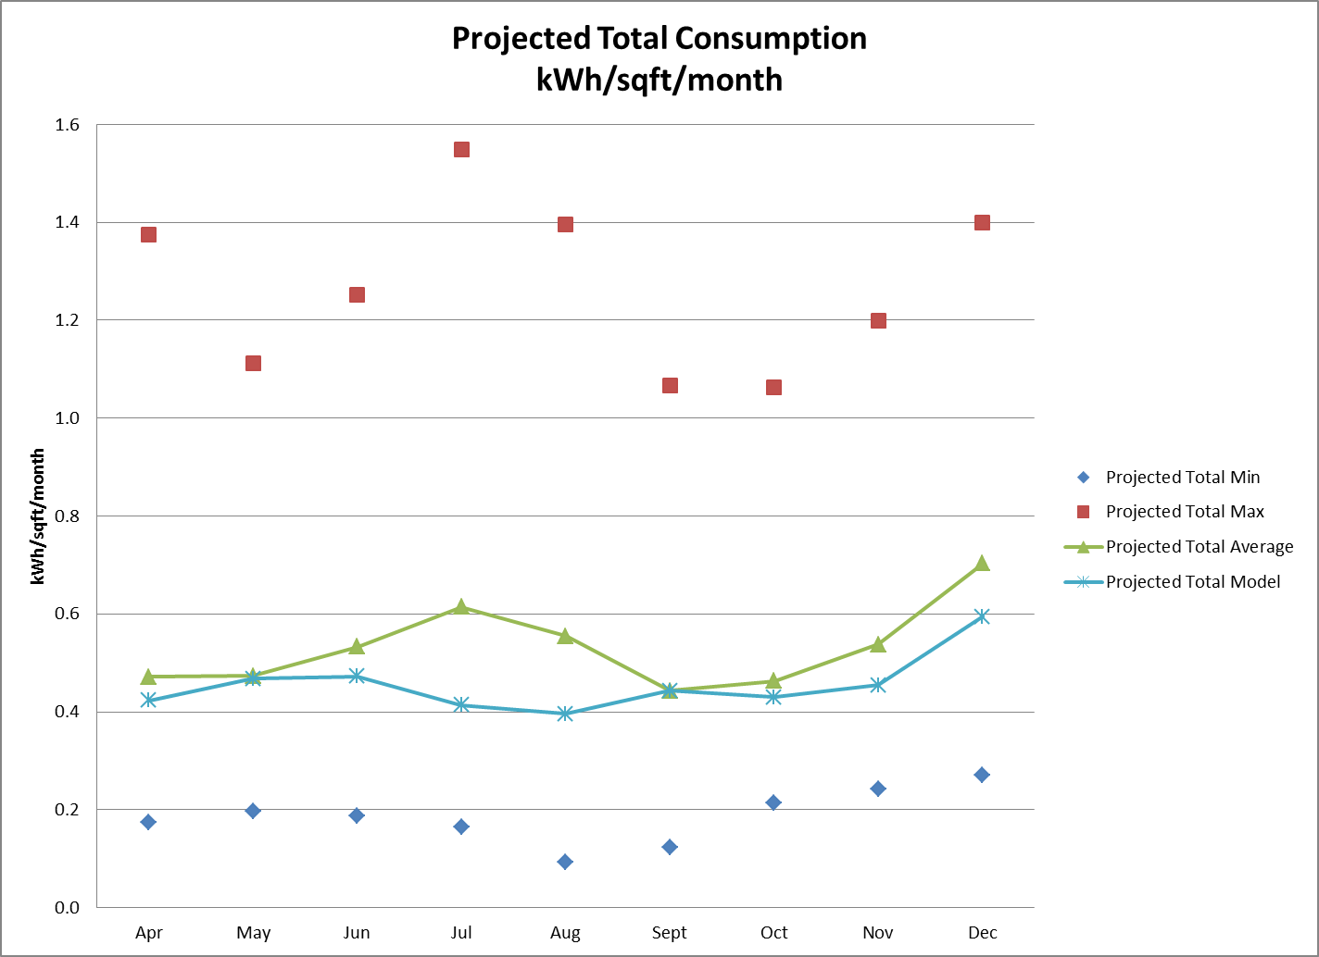
UC Davis West Village
Objective: ZNE Complex
About 15% shy of goal
Consumption of different apartments varies widely… why?

Slide 14
Comparison of Household Energy Consumption
Source: Jukankyo Research Institute
14
Notes:
14

Slide 15
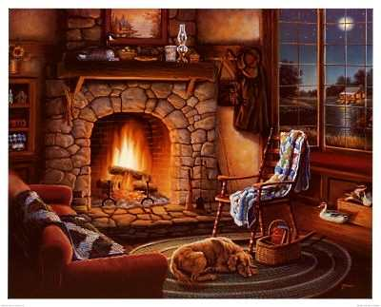
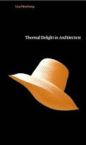
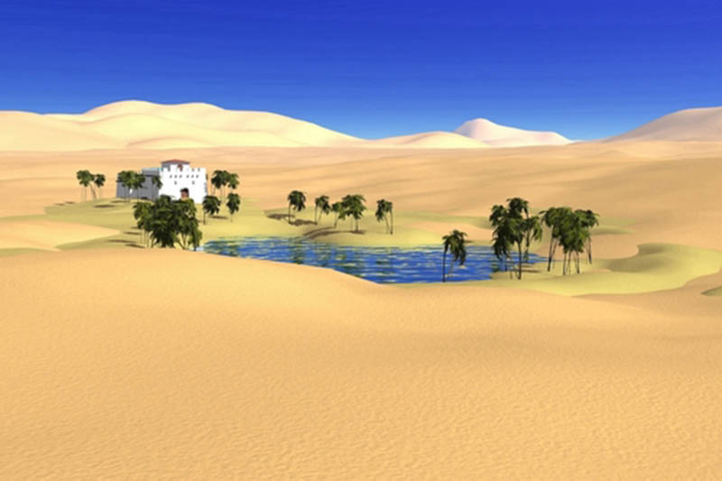
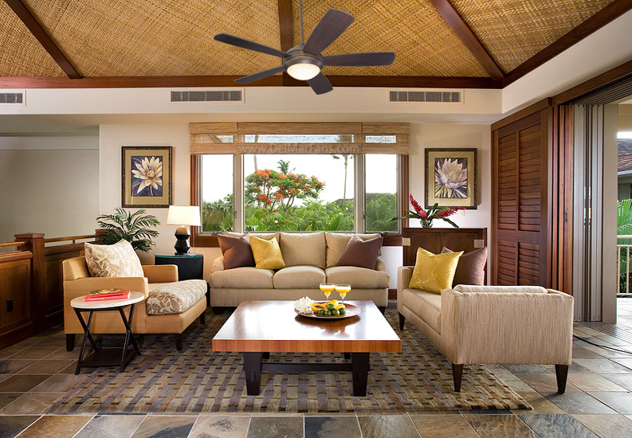
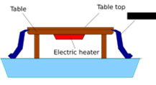

Task/Ambient Conditioning
Brazier
Kotatsu
Room-AC
Jukankyo Institute

Slide 16
FIELD STUDY OF SMART THERMOSTATS

Slide 17
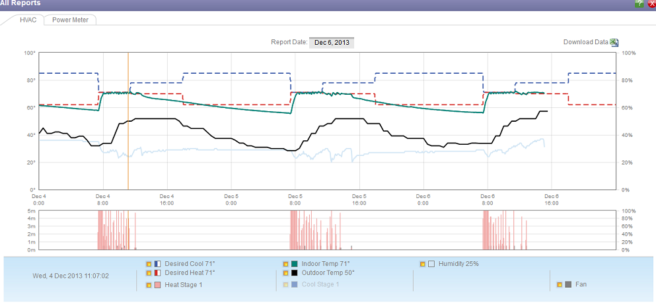
Use of Default Schedules and Manual Operation
“Occupied” and “Unoccupied” settings still set at installation default temps and times of day, months after installation.
Room temperature managed manually, by teacher, using a “hold” feature in the wall thermostat.

Slide 18
The Bottom Line
Participants felt:
Angrier
More powerless
More bewildered
More frustrated
Less comfortable
Less “In-control”
No Significant Energy Savings
Savings Depended on Prior Thermostat Use
Smart Defaults, Third-Party Setting Setpoints
Need for an Ultra Transparent Simple Thermostat
Site | Energy savings
Golf Clubhouse | +3.5% of HVAC power draw per degree F
Small Restaurant | -6.7% of HVAC power draw per degree F
Private School | Pending

Slide 19
WHERE ARE WE GOING NEXT?

Slide 20
Technologies to Improve the Effectiveness of Residential HVAC
Avoiding system use
Task and Passive Cooling
Reducing system runtimes
Thermostat Usability Extremes
Keeping systems working efficiently
Ensuring Occupant or Service Provider Response to FDD Alarms
Optimizing system replacements
Understanding the Role of the Middleman/Perception of Sophistication and Value

Slide 21
QUALITATIVE RESEARCH METHODS

Slide 22
Methods Used in Upcoming Studies
Study | Sponsor | Participants |  |  |  |  |  | Research Methods
 |  | Res |  | Com |  | Mfg,/Dist | Other | Surveys | Focus Groups | SS Interviews | Experiment | Monitoring | Observations
 |  | Owners/Tenant | Contr/Tech | Owners/Tenant | Contr/Tech
Behavior in Emerging Techs: Economizers | SCE |  |  | X | X |  |  |  |  | X
Behavior in Emerging Techs: FDD | SCE |  |  | X | X |  |  |  |  | X |  | X
Behavior in Emerging Techs: Climate Appropriate | SCE | X | X | X | X | X | Specifying Engineers |  | X | X
Behavior in ZNE Homes | Tokyo Gas | X |  |  |  |  |  | X |  | X |  | X | X
Market Intelligence | CPUC |  |  | X | X | X | Government, Utilities, Researcher, Consultant, NGOs |  |  | X
Market Transformation Indicators | CPUC |  | X |  | X |  | Consultants, Utilities, Evaluators | X
Market Assessment of Code Compliance | KEMA | X | X | X | X |  | Code Officials, HERS Raters | X |  | X

Slide 23
What is “Qualitative Research”?
Who? What? When? Where? Why? How?
Behaviors
Environmental context
Emotions
Physical
Social
Legal
Institutional
Cognition

Slide 24
What is it Good For?
Discovery
Identifying themes and relationships
Description
Understanding complex, dynamic multidimensional phenomenon
Comparison
Group A vs. Group B
Explanation
Relationship between sets of variables (causal or non-causal)

Slide 25
How do we Ask People?
Elicitation techniques
Unstructured
Semi-structured
Structured
Informal interviews
Ethnographic interviews
Standardized
e.g., surveys
Semi-standardized
e.g., Focus groups
Provide structure
Provide flexibility
Encourage detailed responses
Elicit different types of data

Slide 26
What Types of Questions can be Asked in a Semi-Structured Interview?
Lists
“Why”
Descriptions
Relations
Compare & contrast people, space & time
Frames
Processes
Mechanisms
“How”
Descriptions of events

Slide 27
What’s so Great about Semi-Structured Interviews?
Balance depth and breadth
Allow us to efficiently collect and analyze rich, qualitative data from many respondents (not either/or)
Ensure consistent data collection across subjects and interviewers
Balance research objectives with resource constraints
Answer complex research questions thoroughly and on budget (i.e., for less than a gazillion dollars)

Slide 28
Why Can’t We Just do a Survey?
You have to know the answers to write the (narrow) questions
When we don’t already know the answers, we have to ask broader questions
How do you calibrate your temperature gauges? (check one)
__Send it to a calibration service provider
__Use an ice bath and/or boiling water
__Someone else does it
__Other _____________________________
__It doesn’t get done
Describe the challenges you have promoting energy efficiency?
Who? What? When? Where? Why? How?
That requires semi-structured interviews.
We don’t know about Grandma.

Slide 29
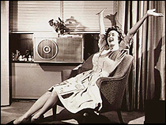
Questions, Comments, Discussion
Thank you!

Slide 30
How Can We do Semi-structured Interviews Efficiently (i.e., For Less Than a Gazillion Dollars)?
Develop logic model outlining the phenomenon of interest
Create semi-structured interview protocol
Use structured data collection instruments
Super cool “spy” pen
Create note-taking table
Build database
Develop coding scheme to convert text to numbers
Analyze data with qualitative and quantitative techniques

Slide 31
Methods Used in Past Studies
Study | Sponsor | Participants |  |  |  |  |  | Research Methods
 |  | Res |  | Com |  | Mfg,/Dist | Other | Surveys | Focus Groups | SS Interviews | Experiment | Monitoring | Observations
 |  | Owners/Tenant | Contr/Tech | Owners/Tenant | Contr/Tech
Maintenance Behavior | SCE | X | X | X |  |  |  | X | X | X
Compliance Motivations | WHPA |  | X |  |  |  |  | X
Usability of In-Home Energy Displays | SCE | X |  |  |  |  |  | X |  |  | X
West Village Energy Use Behaviors | SCE | X |  |  |  |  |  | X
Tiny Steps/Feedback Test | Toyota | X |  |  |  |  |  | X |  |  |  | X
Technician Behavior | SCE |  | X |  |  |  |  |  |  | X |  |  | X
Prevalence of Faults in RTUs | WHPA |  |  |  | X |  |  | X

