Slide 1
California Energy Commission’s
Energy Efficiency Research Activities Related to the HVAC Industry
David Hungerford
Energy Efficiency Research Office
Western Cooling Efficiency Center Affiliates Forum
May 20, 2014

Slide 2
Overview
Energy Efficiency Research Program
EPIC 2012-2014
EPIC 2015-2017
Proposition 39

Slide 3
Energy Efficiency Research Program Overview
Help Californians maximize energy efficiency while reducing energy cost and demand
Coordinate with public entities, utilities and others
Since 1997, approximately $284 million invested for energy efficiency:
76% for buildings
24% for industrial, agricultural and water efficiency

Slide 4
Electric Program Investment Charge (EPIC)
At Governor’s request, CPUC created a new program to address policy and funding gaps in the development, deployment & commercialization of next generation clean energy technologies
Funding authorized for 2012 through 2020
CPUC designated the Energy Commission as one of four administrators
All funds administered under CPUC oversight
First Investment plan submitted to the CPUC on November 1, 2012 and approved in Fall 2013
Funding initiatives incorporate CPUC guidance on clear ratepayer benefits
The funding initiatives are based on:
Guiding principles and policies
Stakeholder comments received
Current knowledge of state-of-the-art technologies
Known barriers and gaps

Slide 5
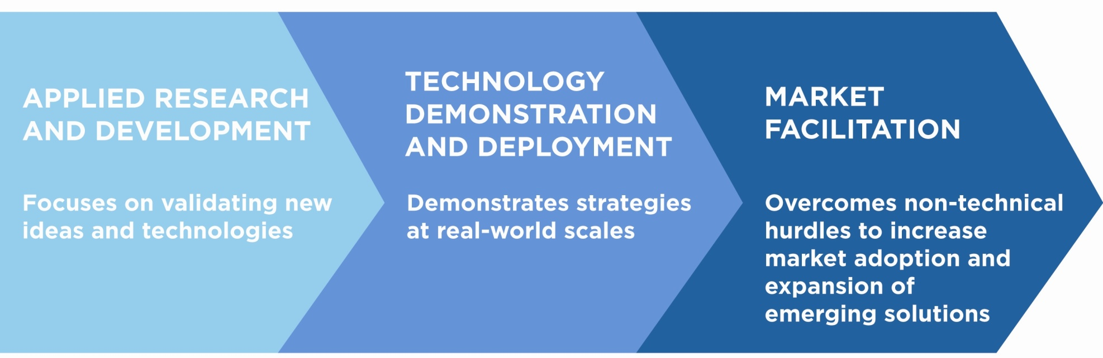
Bringing clean energy ideas to the marketplace for the benefit of California IOU ratepayers
Energy Innovation Pipeline
CEC EPIC Mission
Through EPIC, the Energy Commission will fill critical funding gaps within the energy innovation pipeline to advance technologies, tools, and strategies that provide California’s IOU ratepayers with clean, affordable, and reliable electricity and help enable the 21st century power grid.

Slide 6
EPIC Initiatives—First Investment Plan
Applied Research
Energy Efficiency
Clean Generation
Smart Grid
Cross Cutting
Technology Demonstration and Deployment:
Energy Efficiency and Demand Side Management
Clean Energy Generation and Deployment
Integration of Energy Efficient Demand side Resources, DG and Smart Grid
Cost Share for Federal Awards
Market Facilitation
Regulatory assistance
Workforce development
Market assessment programs
More info at: http://www.energy.ca.gov/research/epic/index.html

Slide 7
Energy Commission 2012-2014 EPIC Budget (Million $)
Funding Element | Total
Applied Research and Development | 158.7
Technology Demonstration and Deployment | 129.8
Market Facilitation | 43.3
Program Administration | 36.9
Total | 368.7
Source: 2012-2014 EPIC Investment Plan, as modified and approved in CPUC Decision 13-11-025.

Slide 8
Upcoming EPIC Solicitations from 2012-2014 Plan
Solicitations Planned Starting March 2014 | Funding Amount (millions)
Developing Technology Improvements for a Flexible and Responsive Electricity Grid | $5.0
Demonstrating Secure, Reliable Microgrids and Grid-Linked Electric Vehicles to Build Resilient, Low-Carbon Facilities and Communities | $26.5
Advancing Grid-Level Energy Storage Innovation to Achieve Policy Goals, Lower Costs, and Spur Investment (PON-13-302) | $6.0
Developing a Portfolio of Advanced Efficiency Solutions: Technologies and Approaches for More Affordable and Comfortable Buildings, Phase I (PON-13-301) | $25.0
Advancing Cleaner, Less Costly, More Reliable Distributed Generation to Enable Customer Solutions and Zero-Net Energy Communities (Strategic Objective S3) | $19.5
Creating a Reliable and Predictable Renewable Energy Future: Advancing Utility Scale Renewable Technologies (PON-13-303) | $9.5
Human Power: Investing in the Future of California’s Clean Energy Workforce | $4.5
Building a Renewable Energy Future that Protects Human and Environmental Health | $11.0
Demonstrating Bioenergy Solutions that Support California’s Industries, the Environment and the Grid (Strategic Objective S13) | $27.0
Bringing Solutions to Scale: Proving New Efficiency and Demand Response Technologies Work for California’s Industrial, Agriculture and Water Sectors | $27.3
Federal Cost Share | TBD

Slide 9
Upcoming EPIC Solicitations from 2012-2014 Plan
Solicitations Planned Starting July 2014 | Funding Amount (millions)
Guiding Future Energy Needs, Plans, and Programs Through Commercial End-Use Surveys, Phase I | $1.0
Developing Technology, Environmental, and Market Roadmaps and Analysis to Guide our Progress | $2.0
Driving the Integration of Electric Vehicles to Maximize Benefits to the Grid | $4.0
Advancing Solutions That Allow Customers to Better Manage Their Energy Demand | $21.4
Leveraging Innovation Clusters to Accelerate Deployment of Early Stage Technologies | $27.0
Developing the Smart Grid of 2020: Clean, Safe, and Highly Intelligent | $8.0
Establish Strategies for Enhanced Local Regulatory Assistance and Permit Streamlining That Will Accelerate Deployment of Clean Energy Infrastructure | $23.0
Reducing Costs for Communities and Businesses Through Integrated Demand Side Management and Zero-Net Energy Demonstrations | $28.0
Guiding Future Energy Needs, Plans, and Programs Through Commercial End-Use Surveys, Phase II | $7.0
Developing a Portfolio of Advanced Efficiency Solutions: Technologies and Approaches for More Affordable and Comfortable Buildings, Phase II | $18.3
Building a Renewable Energy Future That Protects Human and Environmental Health: Phase II | $7.0
Connecting Clean Tech Entrepreneurs, Investors, and Others: Creating the Networks Needed to Bring Energy Innovations to Market | $0.8
Demonstrating Clean Energy Solutions That Support California's Industries, the Environment, and the Grid | $18.0
Measuring Innovation Progress to Guide Future Investment | $4.7

Slide 10
2015-17 EPIC Investment Plan (proposed)
The proposed funding initiatives are based on:
SB 96 (2013 Statute) and other relevant energy statutes and policies.
Stakeholder comments received.
Current knowledge of state-of-the-art technologies.
Existing RD&D efforts, including 2012-2014 EPIC Investment Plan.
Known barriers and gaps.
Proposed funding initiatives incorporate:
CPUC EPIC defined program areas.
Guiding principles and electricity value chain.
Policy and other ratepayer benefits as described in CPUC EPIC decisions.
Greatest potential value proposition for ratepayers.
Schedule calls for CPUC Decision in December 2014

Slide 11
Energy Commission Proposed 2015-2017 EPIC Budget (Million)
Funding Element | Total
Applied Research and Development | $151.63
Technology Demonstration and Deployment | $145.02
Market Facilitation | $53.27
New Solar Homes Partnership (Market Support) | *
Program Administration | $38.88
Grand Total** | $388.8
* Up to $130 million.
** Any additional funds that may be allocated to the Energy Commission as a result of any
CPI adjustment will be used to increase the budget proportionally across all areas.

Slide 12
2015-2017 HVAC-Related EPIC Initiatives
Applied Research
Strategic Objective 1. Improve Energy Efficiency Technologies and Strategies in California’s Building, Industrial, Agriculture, and Water Sectors.
S1.1.2—Develop and test innovative HVAC systems
S1.1.3—Develop and test next generation building envelope performance systems
S1.1.5—Existing building energy efficiency retrofit strategies
S1.2—Develop model designs and strategies for cost-effective zero net energy homes and buildings
S1.3—Apply advanced social science research methods to improve adoption of next generation energy efficiency solutions
S1.4—Develop and evaluate strategies to improve indoor air quality in efficient buildings

Slide 13
2015-2017 HVAC-Related EPIC Initiatives
Technology Demonstration and Development
Strategic Objective 12. Overcome Barriers to Emerging energy Efficiency and Demand-Side Management Solutions Through Demonstrations in New and Existing Buildings
S12.1—Identify and Demonstrate Promising Energy Efficiency and Demand Response Technologies Suitable for Commercialization and Utility Rebate Programs
S12.2—Demonstrate Large-Scale Deployment of Integrated Demand-Side Management and Demand Response Programs in Buildings

Slide 14
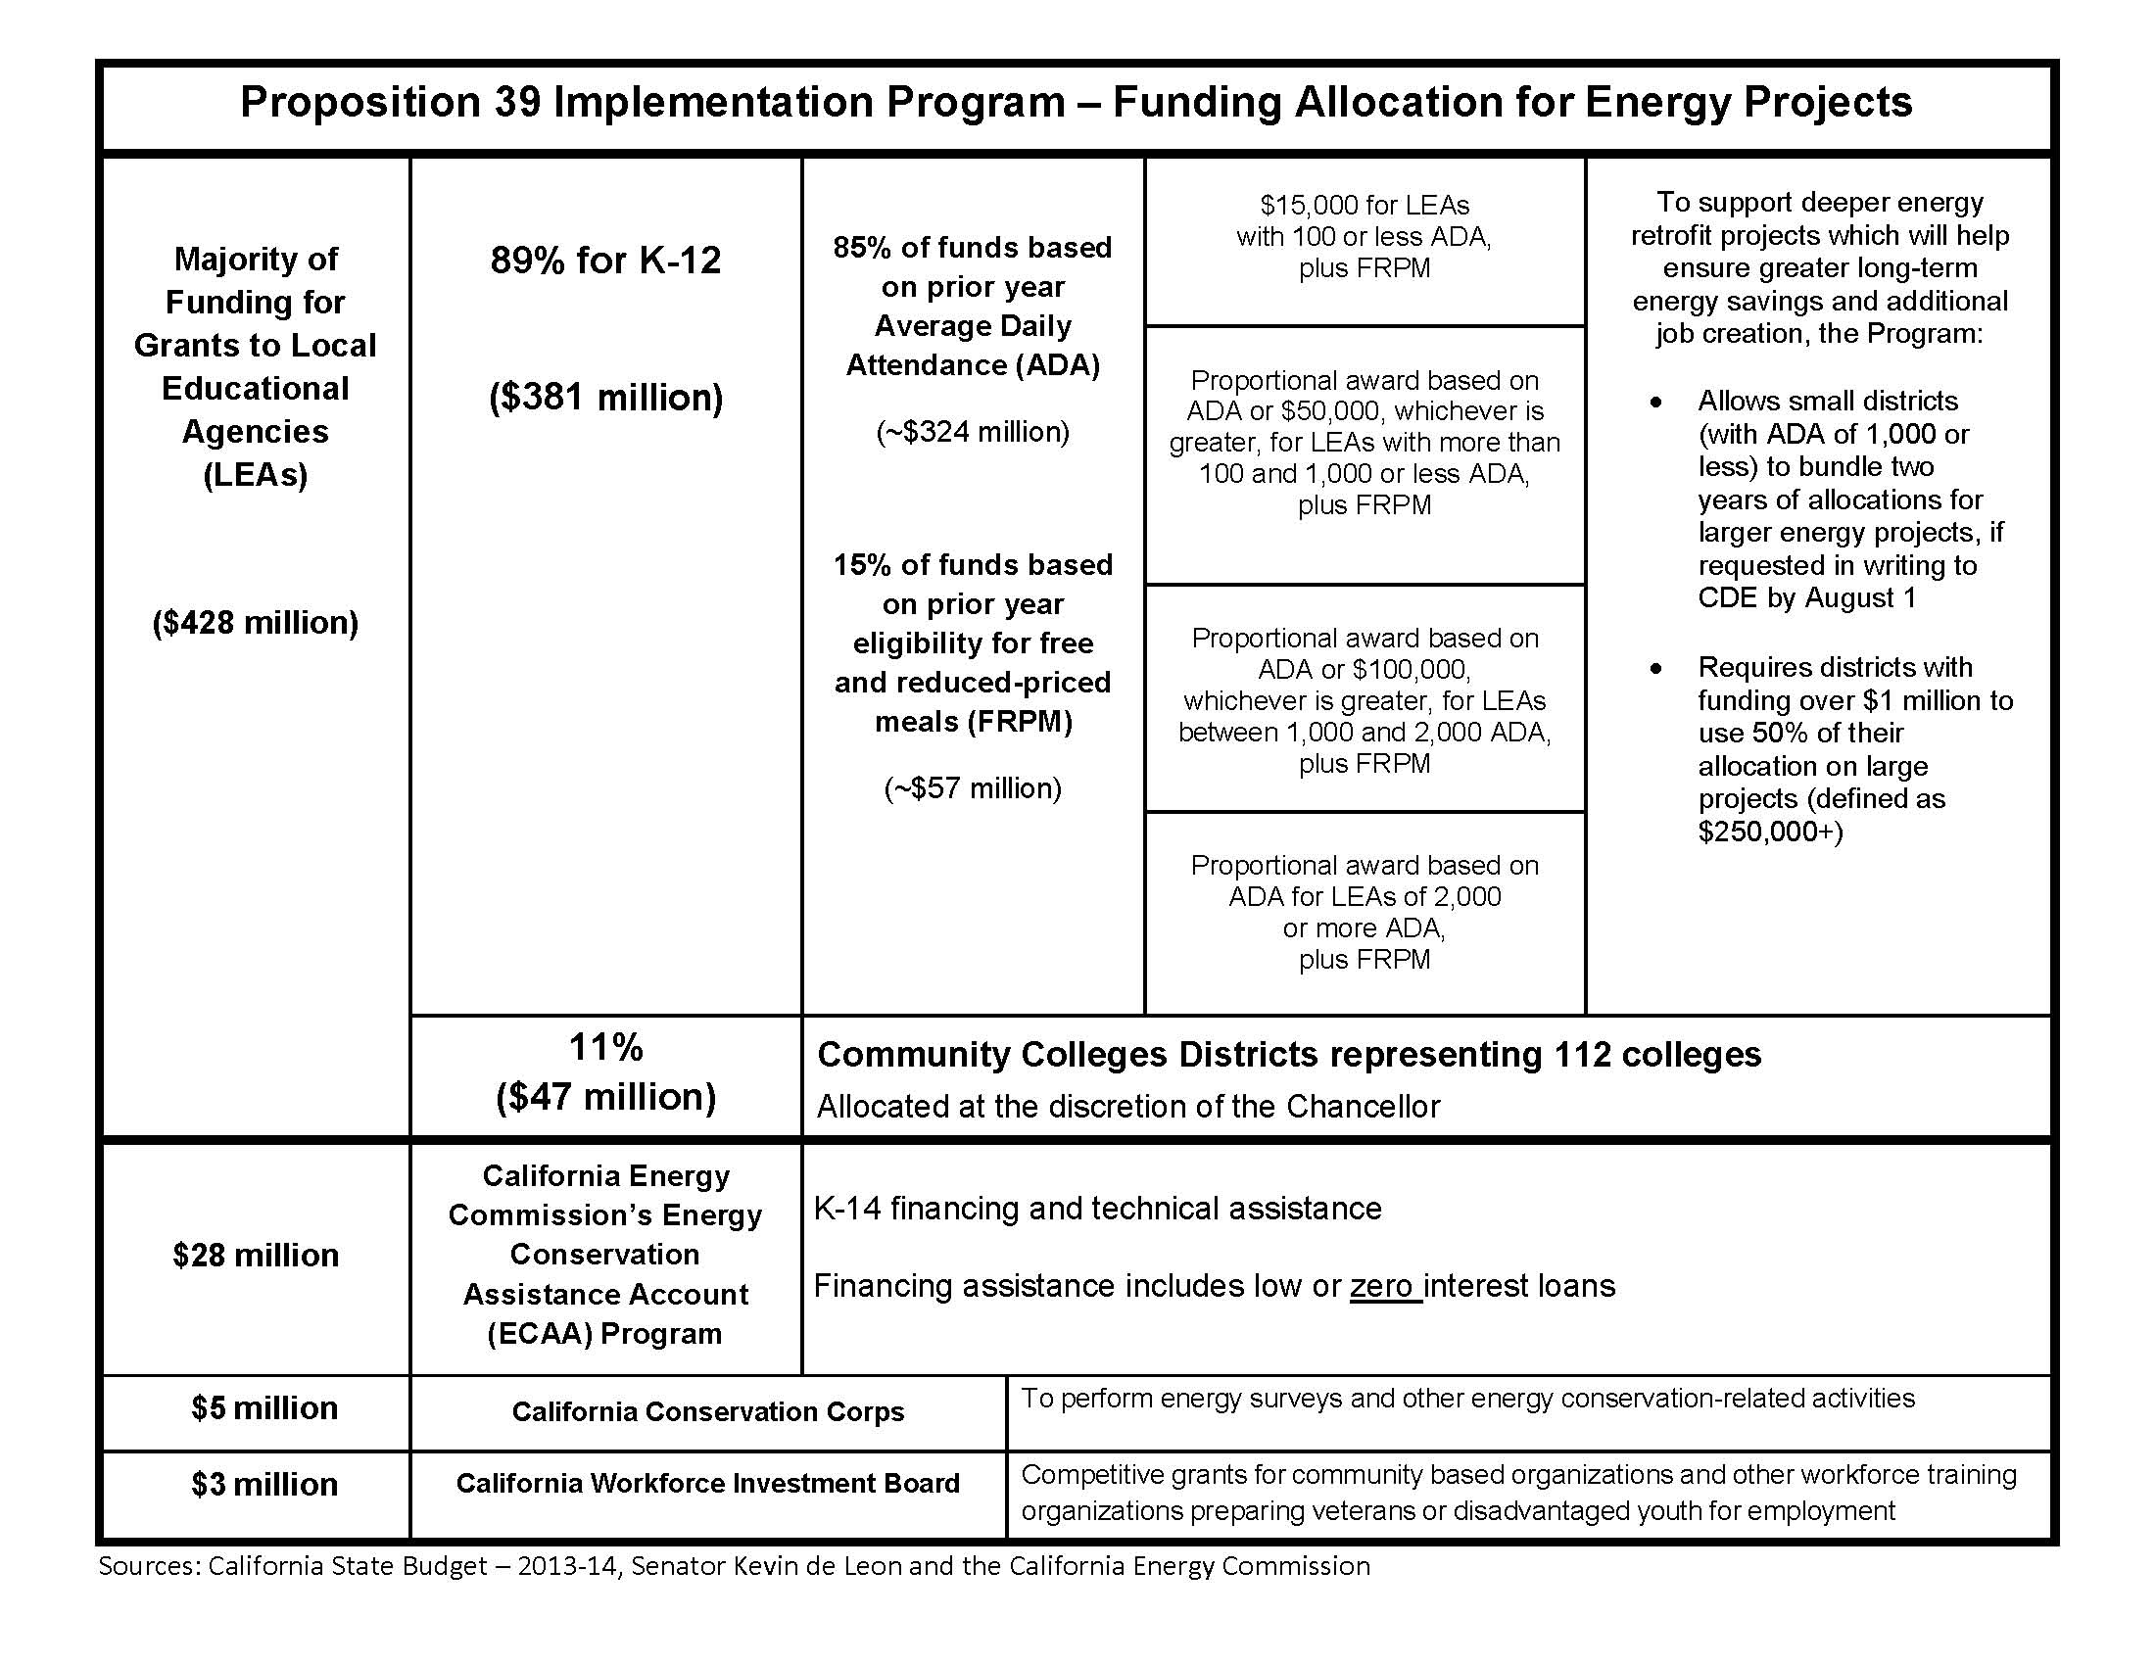

Slide 15
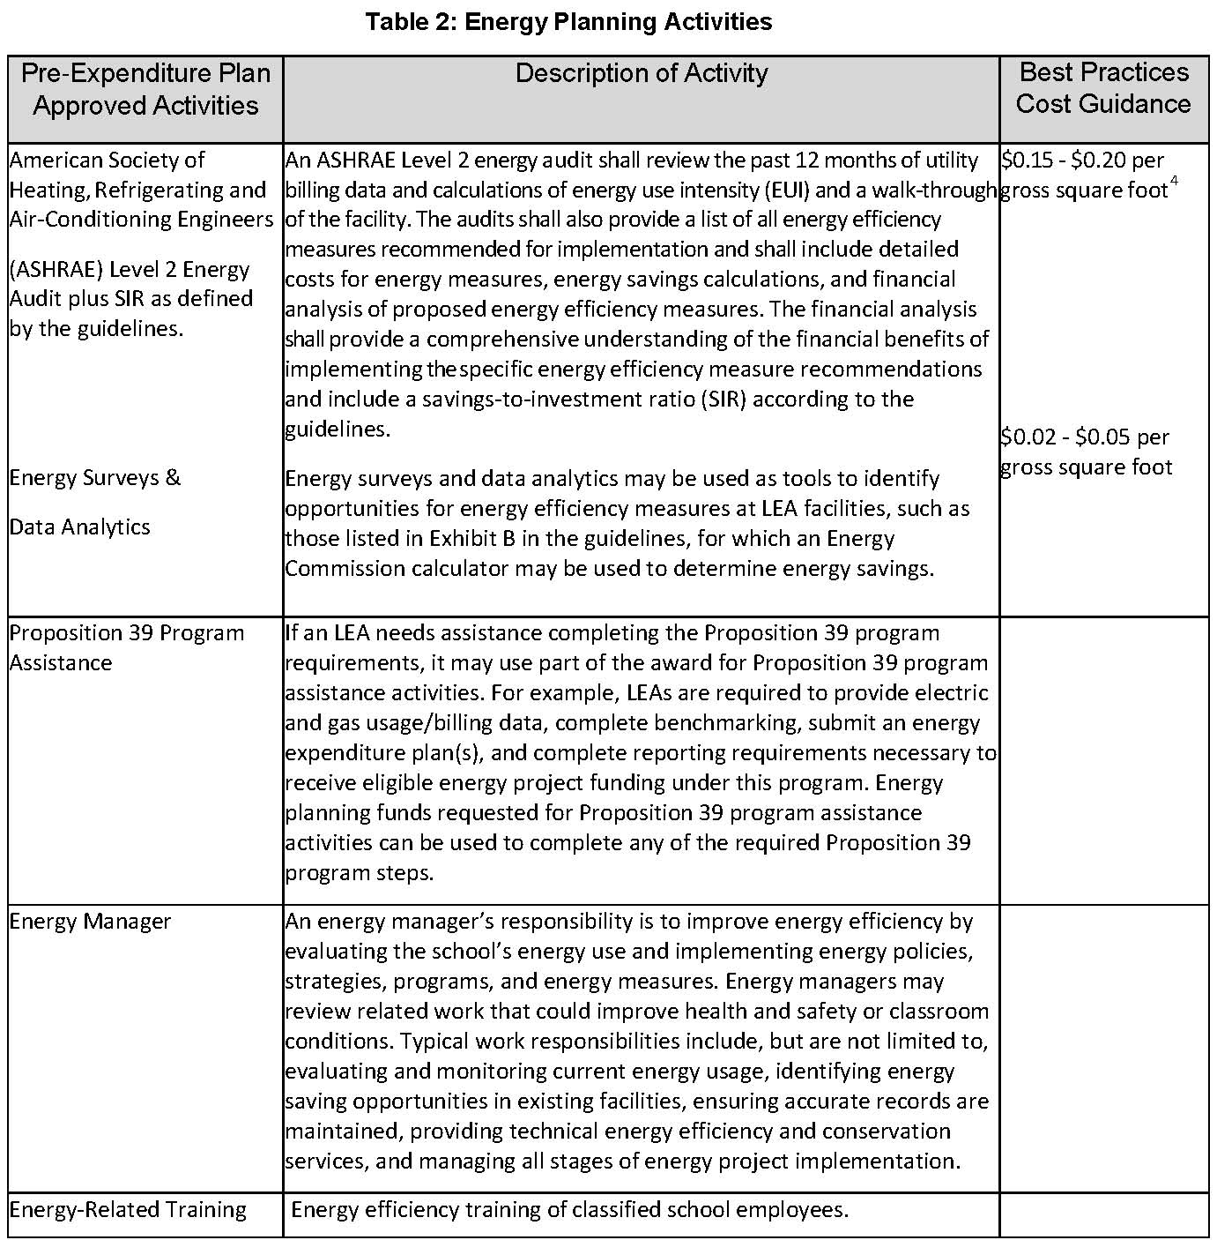

Slide 16
Resources
http://www.energy.ca.gov/research/epic
http://www.energy.ca.gov/efficiency/proposition39

Slide 17
Contacts
Matt Fung, WCEC Contract Manager
matthew.fung@energy.ca.gov
David Hungerford, Lead-demand response, behavioral research
david.hungerford@energy.ca.gov
Virginia Lew
virginia.lew@energy.ca.gov

