Slide 1
Planning for the Future using a Systems Approach
Systems Steering Committee
05/07/2014 – AHRI Spring Meeting

Slide 2
Background
At the 2012 fall AHRI meeting, we reviewed a new initiative that had been approved by the AHRI board to begin to look at a “Systems Approach for Efficiency for Commercial HVAC Systems”
A new group had been formed called the “Systems Working Group” to begin to this work.
The group was staffed with commercial industry experts from AHRI member companies with experience in a broad range of commercial equipment and systems
The working group has been routinely meeting to develop Systems Concept and the goal today is;
Update the Sections and member companies on the status of the work
Update the AHRI members on the overall global industry efficiency improvement initiatives and trends
Engage the sections beginning the transition to a “systems approach” for both new buildings and existing buildings

Slide 3
Agenda
Systems Steering Committee (formerly Systems Working Group)
Review of historical efficiency improvements and future goals
Current approaches to efficiency improvements
Alternate Approaches to efficiency improvement
Review of the Initiatives Identified by the Systems Steering Committee
AHRI Sections Requested Action Plan
Questions and Discussion

Slide 4
Systems Steering Committee

Slide 5
Systems Steering Committee
Systems Steering Committee
(15 AHRI Members)
Industry Expert Consultants
Originally the group was named the “Systems Working Group”
Early this year the name was changed to the “Systems Steering Committee”
This will not be a short term project and will take years to transition to the approach
The core System Committee will not do all the work and it will require strong support from the AHRI Sections and other external groups
Sub-working Groups
Rebates Programs (Consortium for Energy Efficiency (CEE)
Efficiency Standards ASHRAE 90.1, ASHRAE 189.1 DOE
AHRI Sections and Engineering Committees

Slide 6
Systems Steering Committee Members
Charlie Adams – A.O. Smith
Bob Brown – Water Furnace
William Dietrich – Daikin/McQuay
Paul Doppel – Mitsubishi
Drake Erbe – Airxchange (Vice Chair)
Gus Faris – Nailor
Mark Fly –Aaon
Roger Hundt – Lennox
Laura Petrillo-Groh – AHRI (Staff Support)
Richard Lord – Carrier (Chair)
Bill McQuade – JCI/York
Frank Meyers – PVI
Rajan Rajendran –Emerson
Ron Crosby – Trane
Robert Wilkins - Danfoss

Slide 7
Mission
Overall goal is to save energy
Primary focus should be to put together a package to change the path of national energy policy for buildings and the current prescriptive approach used by Efficiency Standards
Must be well defined
Must be justified
Must be credible and verifiable
Ultimately requires regulation changes as well as standard changes
Support actual saving in the installed building (building verification)
Improve the confidence and trust in the energy savings of our equipment
Tools and procedures to support energy savings and evaluation (free)
Key Enablers
Communications (single message, multiple channels)
Trust and credibility
Advocacy, utilities and related organizations
Define where we need to be in the future and the steps and timeline to get there as well as funding and external resources

Slide 8
Historical Efficiency Improvements and Process

Slide 9
Energy Efficiency Background
Since the 1970’s efficiency requirements for HVAC systems have increased using a method of prescriptive minimum requirements defined thru standards like ASHRAE 90.1, IECC, Title 24 and federal requirements (DOE).
Some are controlled and enforced at a national level, and others are implemented at state and city level.
The approach has been to define minimum efficiencies that are based on industry standard full load rating metrics like EER, COP, kw/ton, etc. defined in industry rating standards like the AHRI standards
Recently, for a few of the products, new metrics focused on average annualized performance have been added which include metrics like SEER, HSPF, IPLV, and IEER
All these have been based on one requirement for the USA and with the assumption of equipment sized for the exact building load (no over sizing) and using the same ambient design conditions, but this is beginning to change with regional residential requirements
The also assume that the equipment is properly installed, commissioned and maintained

Slide 10
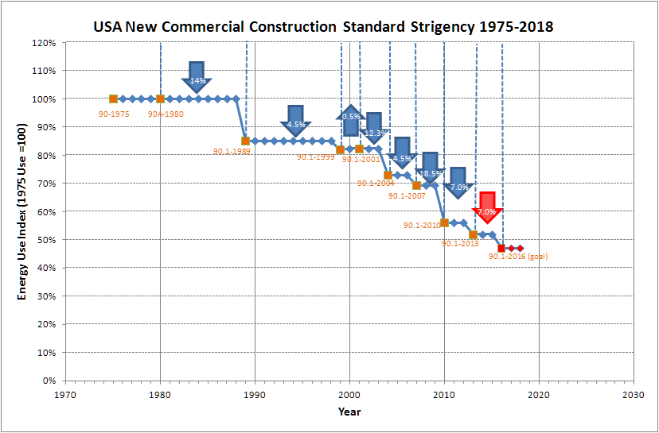

Background – Overall Building Energy
Great progress has been made in Building and HVAC efficiency improvements
Chart based on ASHRAE 90.1-2013 determination study conducted by PNNL

Slide 11
Background – Air Cooled Chiller
Chart based on ASHRAE 90.1-2013 determination study conducted by PNNL

Slide 12
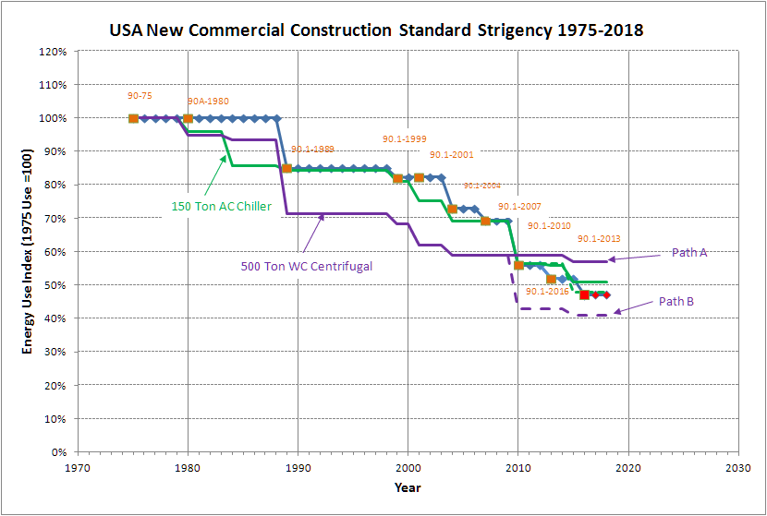
Background – Water Cooled Chiller
Chart based on ASHRAE 90.1-2013 determination study conducted by PNNL

Slide 13
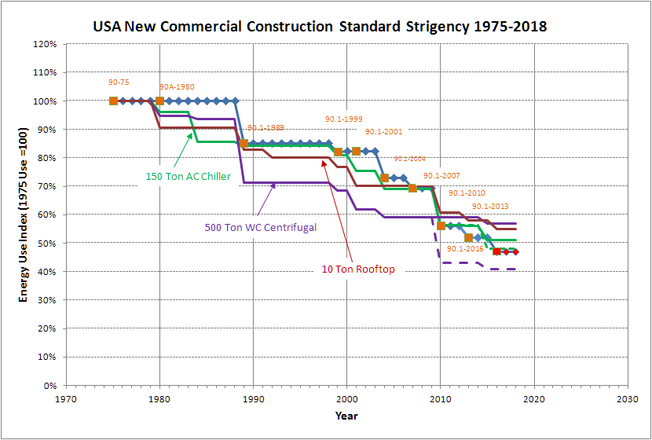
Background – Packaged Rooftop
Chart based on ASHRAE 90.1-2013 determination study conducted by PNNL

Slide 14
Background – Net Zero Energy Goal
The Future Challenges are Significant and can not be obtained with conventional approaches
Net Zero Building Goal
Chart based on ASHRAE 90.1-2013 determination study conducted by PNNL

Slide 15
Historical Approach
The general focus for HVAC efficiency has been to focus on full load design metrics at a common national average rating condition.
There are some part load and annualized metrics, but they are not used on all products and not recognized by some Energy standards and rebate programs
DOE and standards like ASHRAE 90.1 have historically focused on prescriptive minimum requirements for efficiency as well as separate design requirements like economizers, energy recovery, etc.
The focus on prescriptive requirements is increasing
DOE is focused on adding multiple prescriptive efficiency requirements with new initiatives on fan efficiency, motor efficiency, inverter efficiency, standby power, for a total of 11 new NPOR’s and 4 new test procedures in 2013
We likely will end up with multiple metrics for the same unit and possible multiple certification programs
Some of the discussion and proposals for efficiency standards are focused on prescriptive requirements for features like controls, number of stages, how economizers are controlled, supply air temperature control routines and more where they are trying to engineer the solution and not defining the requirements (limits creative solutions)
This is why standards like ASHRAE 90.1 and IECC are growing in complexity and some states are starting to push back that they are too complex and difficult to enforce.

Slide 16
Efficiency Regulation Complexity
Efficiency Regulations
Recent Changes
Light Commercial
(<65K, Single Phase)
Commercial
(≥65K, 3 Phase)
Minimum Efficiency
Higher Tier Requirements
Minimum Efficiency ASHRAE 90.1
Higher Tier Requirements
Federal Regulations
NAECA/ESIA (DOE)
Non Federal Requirements
Federal Regulations
EPAC/ESIA (DOE)
Non Federal Requirements
CEE
EnergyStar (EPA)
DOE Standards and Test Procedures
EnergyStar (EPA)
ASHRAE 90.1 Requirements
ASHRAE 90.1,
IECC
State Codes (Title 20,24)
City Codes
ASHRAE 189.1, 2, 4
LEED
FEMP (DOE)
State Codes
(i.e. Title 20)
AC Rooftops <760K
WC Packaged <760K
AC Cond Units <240K
WSHP
VRF <300K
Motors
Gas Furnace
Fans
CALGREEN
Large Packaged>760
All Chillers
Fan Coils
Air Handlers
Export Products
IGCC
CALGREEN
LEED
Requirements not federally preemptively
controlled and subject to change at the discretion of the author
ASHRAE Advanced Design Guide
Federally Controlled Requirements
Preempt all state and local codes

Slide 17
Regulation Complexity
In addition to the standard historical full load efficiency increases there are many new initiatives that are adding complexity
Fan Efficiency Requirements
US Regional requirements
Many global regional requirements and possible new certification programs
GWP refrigerant phase down (F-Gas and Montreal Protocol)
Prescriptive requirements for economizer operation and leakage
Prescriptive staging requirements
Compressor efficiency requirements in Canada
Extensive refrigeration prescriptive requirement in ASHRAE 90.1
Diagnostic requirements for economizers in California and IECC
AEDM for Unitary Products
Canada verification requirements for non-certified products
Air Cooled chiller limitation in Title 24 and possibly in ASHRAE 90.1
Weatherized Gas Efficiency Requirements?
Addition testing and certification for rooftops with economizers (ASHRAE test procedure being developed)
It is likely we will face multiple efficiency metrics and testing requirements on the same product (Regulation Burden) which will stifle creative new solutions

Slide 18
Background – Efficiency Change Effort
The level of effort to get to the savings is increasing, and it is taking more addendum to reach the same level of savings. It likely will take well in excess of 200 addendum to reach the ASHRAE 2016 goal.

Slide 19
Future Technology Limits
Average ASHRAE 90.1 2013 Requirements
Chart is an estimate of possible future regulations to achieve Near Net Zero by 2034 based on studies done by Carrier on technical limits of HVAC equipment

Slide 20
Cost Effectiveness Challenge
As we approach the technical limits, the cost to increase efficiency increases exponentially and we are finding that some changes can not be cost justified as shown by the recent ASHRAE 90.1 2015 chiller efficiency justification
Overall the capacity weighted payback period was 6.3 years but there is a wide variation by product type and climate zone ranging from -320 years to +37.6 years
Scalar limit is the maximum allowable payback period allowed by ASHRAE 90.1 economic procedures. We know customers really are only willing to accept 3-4 yrs
Chart from ASHRAE 90.1 Addendum CH to the 2010 Standard Justification Analysis

Slide 21
Systems Approach to Efficiency

Slide 22
Understand How Buildings Operate
To fully understand how to save energy in buildings we need to understand how buildings operate
With the focus on prescriptive requirements and full load metrics, standards committees typically have not considered how buildings actually operate
The focus has been on components and not how the component actual operates in a system. It is assumed that if the components are good at full load it will represent the best overall efficiency.
Typical approach is to use national average full load design temperatures and not consider that 99% of the time the equipment is operating at part load and reduced ambient conditions and the impact of regional weather and different building load profiles.

Slide 23
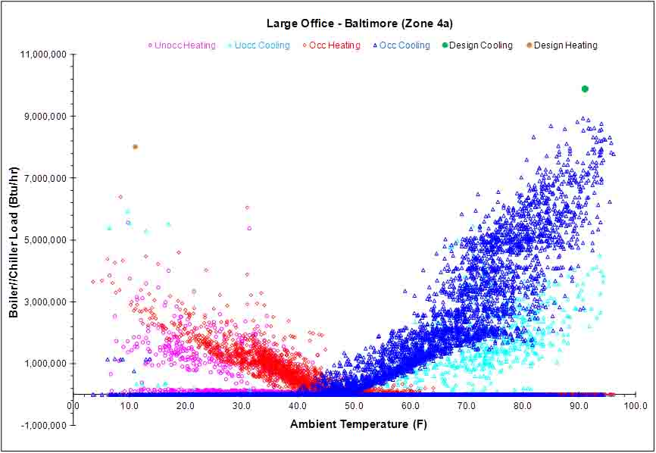
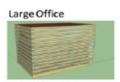
Typical Commercial Office Building
15% Cooling Oversize per ASHRAE 90.1
25% Heating Oversize per ASHRAE 90.1
Office Buildings also requires 17-25% ventilation air to comply with ASHRAE 62.1

Slide 24
Typical Commercial Office Building
Typical Residential Profile
Commercial Building Load Profiles are different than residential

Slide 25
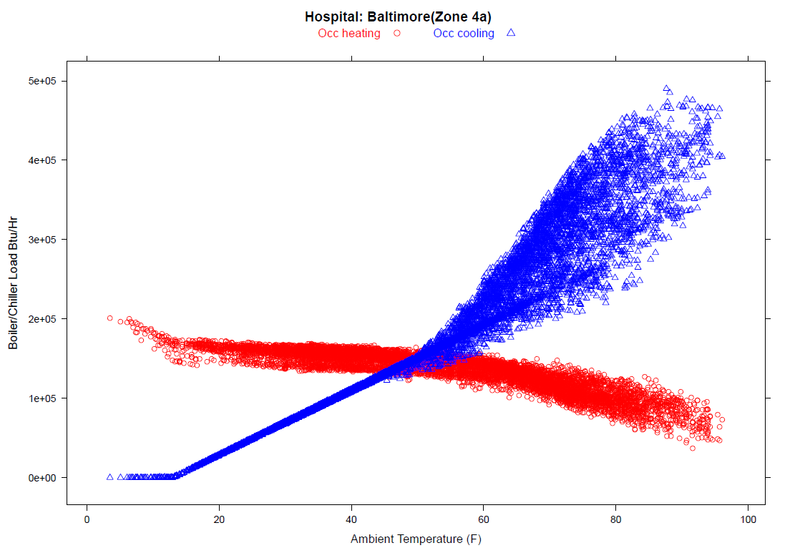
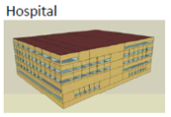
Typical Commercial Hospital
Hospitals often have significant simultaneous cooling and heating

Slide 26
Climate Data – Zone 4a (Baltimore)
Regulations tend to focus on the design conditions, but as you can most operation is at off design ambient conditions which is very important to HVAC because efficiency changes with ambient conditions
0.4% Design Drybulb =93.9 F

Slide 27
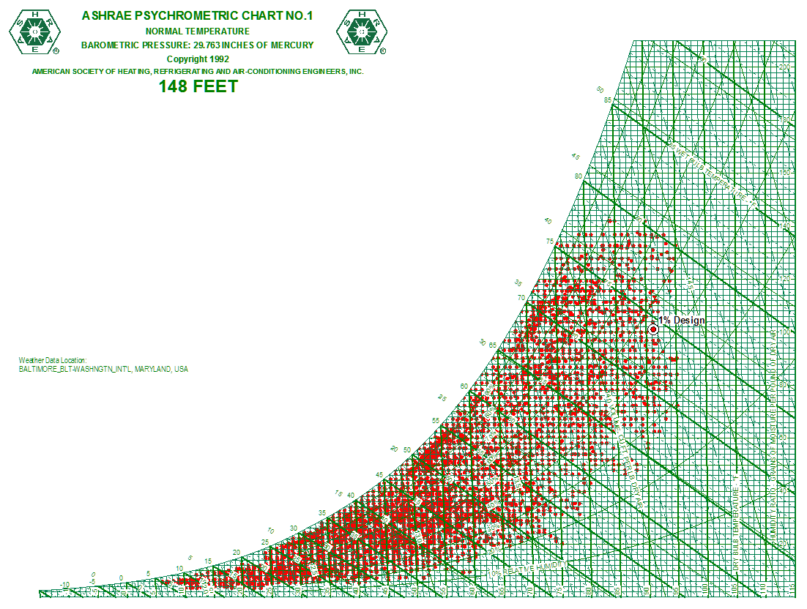
Baltimore Annual Weather Data
Another way we look at the data is to plot each hour on a psychometric chart

Slide 28
Annual Climate Data – Dry Bulb

Slide 29
Climate Zones (Old ASHRAE 169)
Design conditions and dehumidification requirements change by region and regions are beginning to request regional specific design requirements

Slide 30
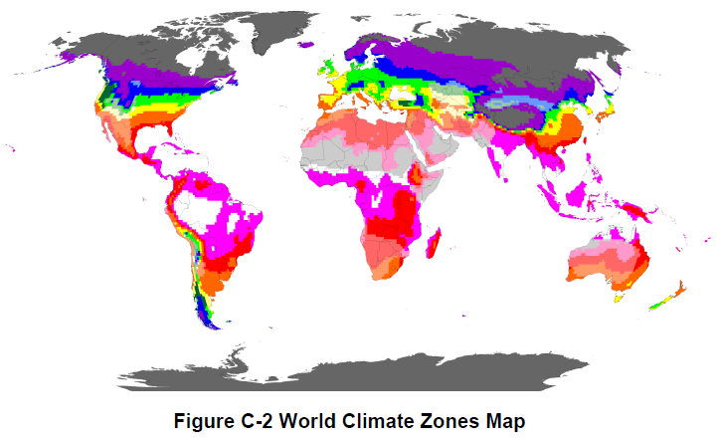
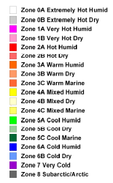
New World Climate Zone Map
Global requirements are changing to regional requirements which will complicate ratings and certification. Most are focused on full load operation.

Slide 31
Alternate Approaches to Efficiency Improvement

Slide 32
Future Efficiency Improvement Options
Historical Approach (Business as usual) - Full Load Improvements
As noted we are approaching “Max-Tech” on many products and significant improvements in base product full load efficiencies will be limited and often not cost effective
We also face issues with the phase down of the HFC refrigerants that are used today, and will have to evolve to new lower GWP refrigerants that may not be as efficient, could be semi-flammable and could be more expensive to apply
Alternate Approaches to Consider
Switch to new part load or annualized metrics like IPLV for chillers and IEER for rooftops, splits, and VRF
Hybrid system with rating approaches like AHRI guideline V
Subsystems approaches (Look at the complete HVAC System)
Whole Building System approaches (ASHRAE Building Energy Quotient)
Defined commissioning requirements to make sure equipment runs correctly
Integrated Fault Detection (FDD)

Slide 33
Option 1 – Part Load and Annualized Focus
For many products like chillers, packaged products, and VRF systems, AHRI has adopted new part load metrics like IPLV, IEER, etc to supplement the full load metrics
The part load metrics are based on a weighted USA average models of typical commercial buildings.
They are intended to be a better representation of the efficiency of a product over the annual operation but have their limitations.
They are just a metric for the energy use of the equipment and do not factor in regional weather and the system energy and impact from components like air side economizers, water economizers, hybrid systems, cooling towers, pumps, and in some cases the indoor air handling equipment
They add considerable testing to certification programs, and tolerances and uncertainty of measurement are a challenge
They are not intended to predict the energy of a building and are intended to be just a means to compare equipment at other than a full load design point
Adoption has been slow and often do not fit the current regulatory environment of DOE which is an appliance based approach
We still have many products that have not adopted a part load or annualized metric

Slide 34
Option 1 – Part Load Metrics
The following are the current metrics for AHRI Standards
Total Number of Standards 94
Number of Certification Programs 34 (36%)
Number of Standards with part load metrics 7 (7%)
Complete Operating Map Certification 2 (2%)
In addition most certification program are US and North America focused
Certification programs do not always cover the full range of products offered
There are only a few heating part load metrics
All rating requirements are current based on US average temperature conditions
Part load metrics help focus efficiency improvements on the overall annual operation and not just the full load design point

Slide 35
Option 2 - Hybrid Systems
The concept for a hybrid system approach is to take two or more technologies and combine them together utilizing some type of combined rating.
During the annual operation each hybrid technology is used where it delivers the most benefit
Some examples are;
Airside economizer
Hydronic economizer
Free Cooling refrigerant cycles
Integrated Heat Recovery
Integrated Exhaust Air Energy Recovery
Dual fuel heat pumps
Dedicated outdoor air systems
Thermal Storage
Energy storage
Desiccant systems
Evaporative pre-cooling condensers
Evaporative outdoor air coolers, direct and indirect
Desuperheaters and integrated hot water heaters
Solar assisted units

Slide 36
Option 2 – AHRI Support of Hybrid Systems
Today there is only one AHRI hybrid system rating and it is Guideline V which gives a full load rating for a combination of an air cooled packaged product (AHRI 340/360) and an energy recovery device (AHRI 1060).
It only has a full load metric at this time, but there is work underway to develop a part load metric.
The metric has not been adopted by regulations and rebate programs to date, but recently CEE (Consortium for Energy Efficiency) is considering a new rebate approach using the guideline V CEF concept
Under this option AHRI and industry regulations would support further development and use of combined rating guidelines and standards.
There are many systems that could benefit from this type of rating procedures

Slide 37
Example Combined Efficiency
ERV Recovered Energy Efficiency Ratio
RTU Energy Efficiency Ratio
RER
EER
CEF = Combined Efficiency Factor
Example:
Rooftop + ERV = System CEF (30 ton system)
EER & RER = CEF
12.0 & 124.69 = 17.19
17.19 System EER for a 30 ton total system

Slide 38
Efficiency Comparison (ERV Example)
Example shows how over the operating range a hybrid unit like an ERV/Rooftop can have further improvements at non standard rating conditions
 | Base Rooftop Unit | Combined
Model: | Rooftop | ERV
Location: | Tampa, FL | Tampa, FL
Altitude (ft) | 0.0 ft | 0.0 ft
CFM | 3500 | 3500
Ext static press: | 0.75" | 0.75"
Ventilation Air: | 50% or less (economizer) | 50% OA (1750 cfm)
ERV CEF

Slide 39
The Basic Approach to Subsystem Efficiency
Efficiency = output/input
Input
Certified
Output
So, another way of looking at this is
Efficiency = ∑ outputs/ ∑ inputs
Certified
Certified
Certified
Output
∑ inputs
A key to the effective use of this is to get acceptance of using certified components and then combine them without adding another certification program

Slide 40
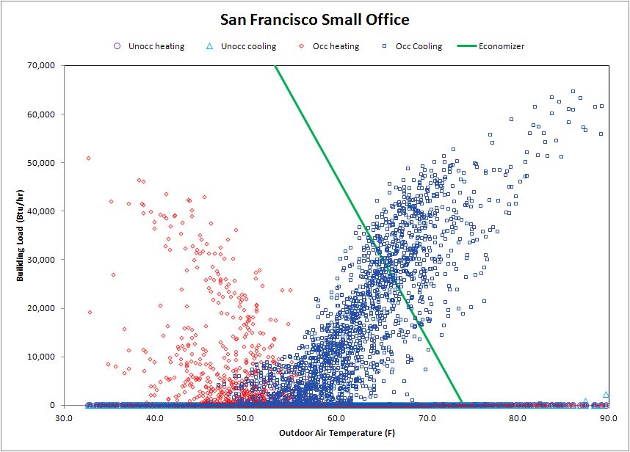
Economizer System Impact Example
Integrated Economizer
Comp + Economizer
1316 hrs
Economizer only Operation
1322 hrs
Mechanical Cooling
No Economizer
73 hrs

Slide 41
Option 3 - Subsystem Approaches
Today, AHRI Standards and efficiency regulations like ASHRAE 90.1 and DOE focus on components and equipment at standard ratings conditions and typically at full load.
There is no direct tie to building level performance and local weather conditions
Metrics on performance often do not cover the applied energy use of the system when installed in a building, so the overall performance is not determined and it may not be the optimal.
Often additional power is used in the application, conditions are different than the standard rating conditions, and additional hardware is added to complete the system
So the concept of a subsystems approach is to expand the scope to cover the HVAC subsystem and not just the components plus focus on annual operation and not full load

Slide 42
Chiller Water “System” Example
ASHRAE 90.1 fan power requirement, no approach requirement and ignore water use
Do not address multiple chillers and towers although most are applied that way
Cooling Tower
Condenser Water Pump
No focus on condenser water pumping power other than a pipe sizing requirement
Condenser
Current 550/590 Chiller Standard and Certification focus
ASHRAE 90.1 Full and part load efficiency
Compressor
No focus on chilled water pumping power other than pipe sizing
Evaporator
Chilled Water Pump
No integration of economizers, exhaust fans, ERV and IAQ
Air Handler
No focus on duct pressure drop and very little on applied fan power
Outside
Air
Very little focus on the effective air distribution
Conditioned Space

Slide 43
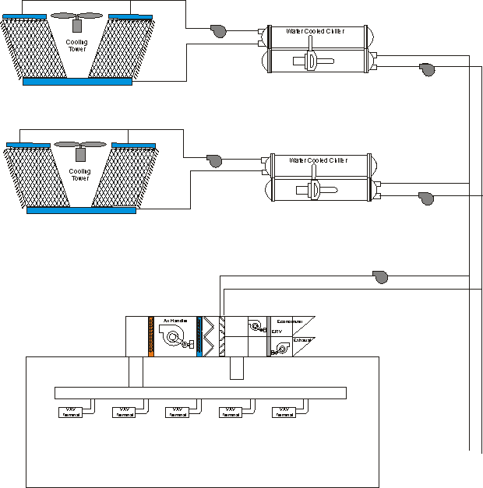
Chilled Water System Example (Current)
Current ASHRAE 90.1 Regulations (Prescriptive Approach)
HP/GPM
Full Load & IPLV
HP/GPM
Full Load & IPLV
Component Efficiency Requirements
No Requirements
Prescriptive Requirements
Maximum Fan Power
CO2

Slide 44
Chilled Water System Example (Proposed)
Proposed Systems Approach
Annualized HVAC System Efficiency (annualized)
Overall Efficiency Minimum Set by climate zone and building type and then component efficiencies can be traded off to meet the overall targets
Maximum Fan Power
CO2

Slide 45
Example System Level Metrics
Larger Office Building Cooling Example
The following example shows what the targets might look like for a typical large office building.
We will likely use some efficiency metric like watts/ft2 or kw/ton
Base 200 Ton AC Chiller has an 11.1 EER and 14.0 IPLV
Chart prepared by Richard Lord for the ASHRAE 90.1 Chilled Water Plant Analysis

Slide 46
Option 4 - Overall Building Energy Metrics
Various whole building rating systems have been developed and are being developed and are being adopted in some cities, Canada, and Europe
These are a good approach, as they allow one to consider the complete building as a system and to optimize the energy and cost
But the tools to reliable predict the energy of buildings are inaccurate at this point, expensive to run and are used on less than 20% of buildings
AHRI and it’s members could assist in improvements to these tools
Provide detail model data for simulation correlations thru efforts like ASHRAE 205 - Standard Representation of Performance Simulation Data for HVAC&R and Other Facility Equipment
Develop new improved correlations and model methods for equipment
Provide complete certified operating map data for equipment in formats that can be used with simulations tools

Slide 47
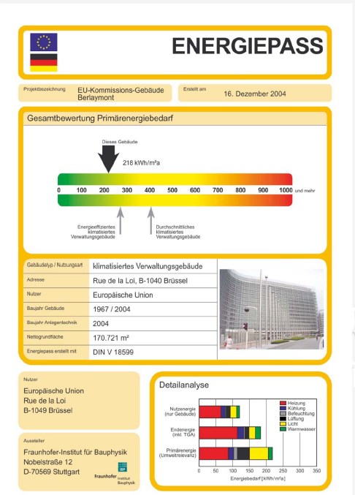
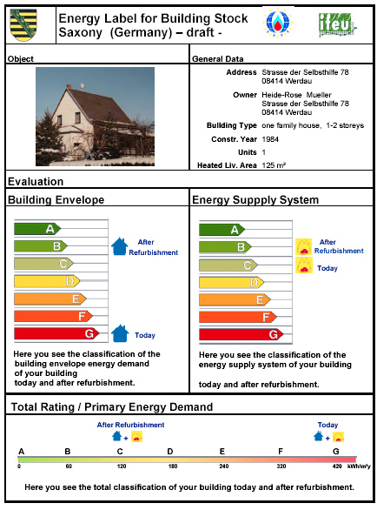
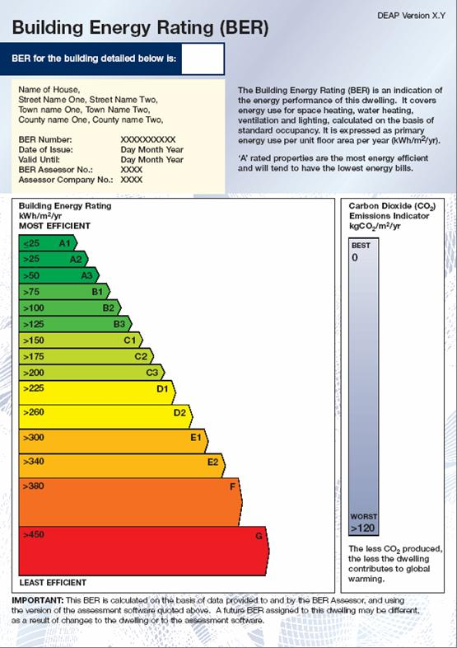
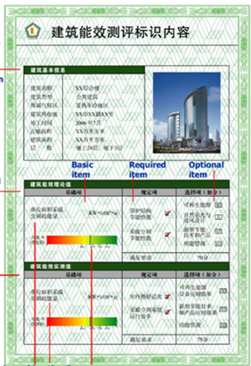
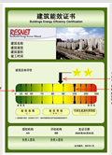
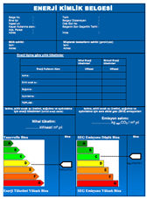
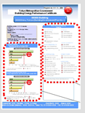
Option 4 - Whole Building Metric
Globally there are initiatives underway to implement whole building metrics as well as policies involving the use of the metrics
ASHRAE
Germany Commercial
Germany Residential
European Union
China
Shanghai
Turkey
Japan

Slide 48
Equipment Ratings and Building Models
We current focus most rating standards and certification programs on a single full load rating points
Certification programs only validate the full load and some check a few part load points
We also lump some energy use devices together which makes equipment modeling difficult (indoor fan in rooftops and packed equipment)
The building modeling industry wants a fully certified map or model that can be electronic linked into the simulation programs without significant post processing
They also want to link technologies together to create subsystems
Show in the graph is a typical operating map for air cooled chiller and where we certify
The ratings only use 2 of the rating dimensions, load and ambient, but also there are changes in evaporator water temperature, flow and altitude that impact ratings
For a typical packaged rooftop it takes 7 polynomial equations to model and we have found the approach to be inaccurate especially the new part load optimized units

Slide 49
Equipment Ratings and Building Models
When someone does want to model our equipment in building models our current metrics are not very useable for the modeling
For example ASHRAE 90.1 has tried to reverse engineer the SEER and EER to generically remove the fan power so they can model the equipment in building models
COP_{nfcooling} = 7.84E-8 × EER × Q + 0.338 × EER
COP_{nfcooling} = –0.0076 × SEER2 + 0.3796 × SEER
COP_{nfheating} = 1.48E-7 × COP₄₇ × Q + 1.062 × COP₄₇
(applies to heat-pump heating efficiency only)
COP_{nfheating} = –0.0296 × HSPF² + 0.7134 × HSPF

Slide 50
Key Enablers to Systems Approach
To address HVAC&R as a system the required tools and procedures are not fully developed and standardized
Modeling Tools - Modeling tools and procedures that can accurately model the building as a system (Industry has tools but there is little validation, and 100’s of assumptions are required to run a tool)
Equipment Models – To model buildings and systems requires models of HVAC&R equipment which do exist, but studies have shown that they are not very accurate and do not model the equipment we are now producing
Verification of Equipment Performance – Today we have our certification programs that verify performance at a peak load design condition and some cases at a few part load points, but not the full map
Automated ways to transfer data – The development of models of HVAC equipment for building models is currently a manual process and very time consuming Standard like ASHRAE 205 are trying to improve by need AHRI support.
Acceptance as a Compliance Path – Regulators are reluctant to accept a performance based approach and in fact are moving to prescriptive approaches that tell what technology should be used.

Slide 51
Equipment and Component Model Data Bases
DOE on their own created a data based for exchange of rating information, but it has no security, revision control or ties to certification data.
This could be a good method but we need to address security and involve manufacturers, AHRI and the distribution methods used to sell equipment including technical support
Also the modeling methods and performance data need to be improved and correlated to modeling tools like ASHRAE 205 Standard

Slide 52
Option 5 – Commissioning
Another opportunity to significantly reduce building energy use is commissioning and re-commissioning of units and systems as well as maintenance to make sure they continue to run.
Most energy regulations and standard focus on the design of the units but very little attention is paid to the installation and operation
Studies have shown that significant energy can be saved by proper installation and maintenance of units
Efforts in this area would reduce the overall energy of a building as well as reduce refrigerant leaks by routine maintenance of the units
AHRI, ASHRAE and other organizations can help with the development of standards, continued training and certification of technician.

Slide 53
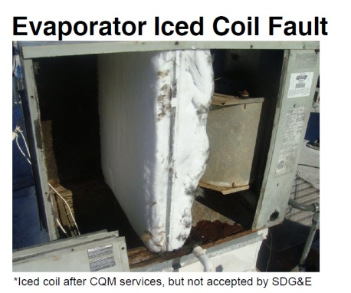
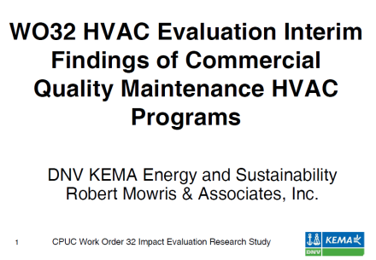
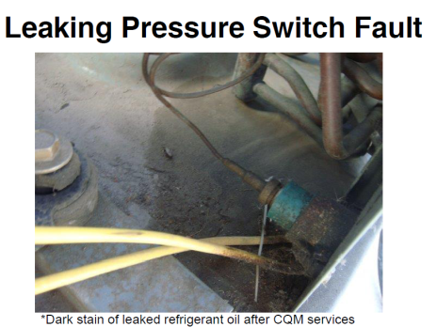
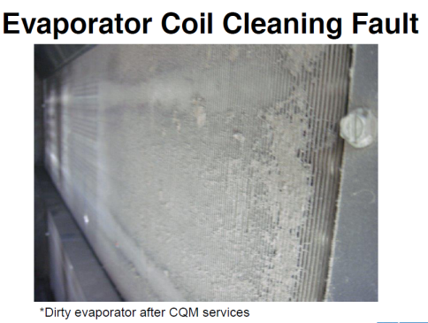
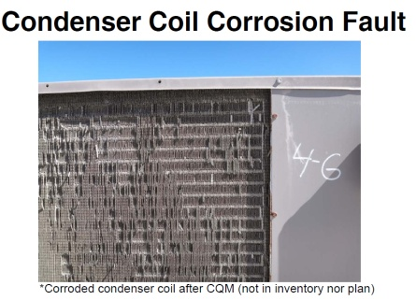
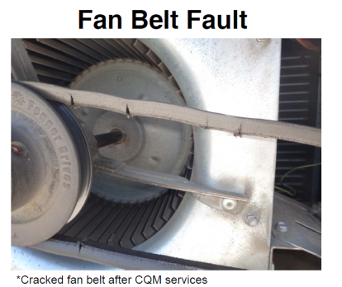
Option 5 – Commissioning and Re-commissioning
Typically efficiency standard focus on the “as designed performance”
We all know that equipment is often not properly commissioned
We also know that maintenance is an issue and the general practice is to fix when it fails.
There are also issues with technicians training as well as turnover
As an organization of manufacturers we tend to focus on rating and testing standards, but there is a lot we could do with guidelines and best practices to make sure equipment is commission and maintained.
Some recent audit studies of commercial rooftops in California show some very poor commissioning as well as maintenance

Slide 54
Option 6 - Diagnostics
Along with commissioning, advanced diagnostics can be a valuable tool to insure proper operation and maintenance of units.
When advanced controls diagnostics can be included into the equipment which can be used to insure proper operation of the unit as well as assist in maintenance
Recently there has been interest in this approach as part of the DOE rooftop challenge, and California has added diagnostic to their proposed Title 24 2013 standard for economizers and are evaluating more for 2016
At this years AHRI/ACCA joint futures meeting diagnostics was chosen as one of the top three priorities that we should focus on as an industry
It was also highlighted at a Smart Grid DOE meeting last week at NREL
This is another area where AHRI, ASHRAE, and other organization members could help in establish guidelines and protocols.

Slide 55
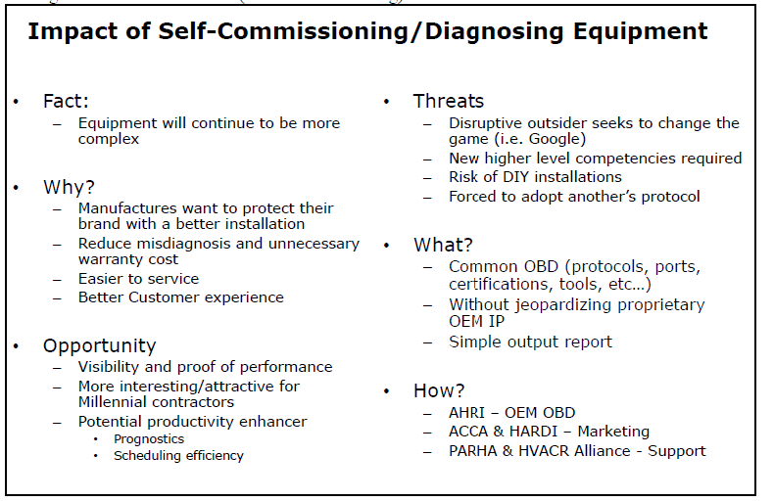
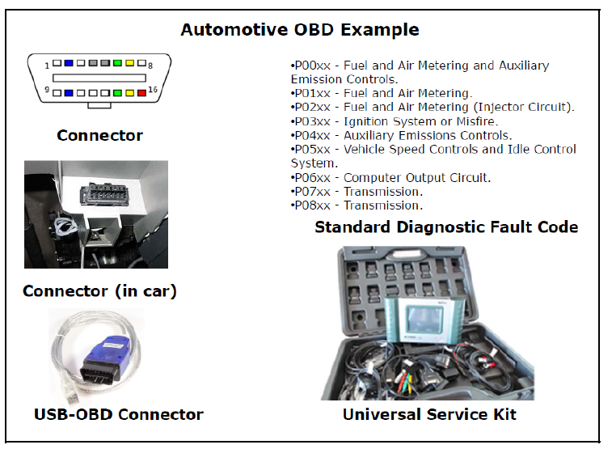
Option 6 - Diagnostics
Shown is the summary slides from the AHRI/ACCA joint futures recommendation on diagnostics
They also question why the HVAC industry can not use a common diagnostics plug like the auto industry OBD plug

Slide 56

Future Roadmap
Our Historical approach of using prescriptive requirements for components has been used since the 1970’s and is reaching the technological limits and alternate approaches need to be considered
Future Energy Reduction Strategies
?
Subsystems and Systems Approach
Historical approach using prescriptive component requirements
Status Quo - We feel this will have limited success and will be costly
Change required - will require different tools, revision to standards and to federal laws

Slide 57
Systems Steering Committee Initiatives

Slide 58
AHRI Systems Working Initiatives
The Systems steering committee has identified 16 initiatives that AHRI should focus on;
Indentify Industry Standard Systems
Strategy to support the use of system rating maps
Develop system rating and analysis computer tools
Identify new full load and part load metrics
New research projects to support the analysis of systems
Form Super-sections that can be used for systems analysis and certification
Develop Guidelines/standards for combined ratings
Develop procedures for electronic transfer of rating maps and support of ASHRAE 205
Indentify Products that are not covered by AHRI Standards
Strategy for Smart Grid Interface
Retrofit Strategies including tools and guidelines
Strategy for Building Interface Controls
Develop new guidelines for application of products and maintenance
Develop AHRI Standards and Guidelines for Diagnostics and Prognostics
Legislative and Standards Changes
Communications

Slide 59
Overall Work Plan
Building Energy Savings
Task 16 - Communications
Building & HVAC Design
Building Operation
Other Initiatives
Codes and Standards
Complete HVAC Systems Approach
Subsystem Approach
New Equipment Metrics
Task 1 – System Diagrams
Task 2 – System Rating Maps
Task 4 – Full and Part Load Metrics
Task 10 – Smart Grid
Task 6a – Super Sections
Task 15a – Legislative Structure
Task 2 – System Rating Maps
Task 7 – Combined System Ratings
Task 2 – System Rating Maps
Task 12 – Building Controls
Task 6b – Certification Programs
Task 15b – Overall Efficiency Approach
Task 3 – System Evaluation Tools
Task 13 – Application & Maintenance
Task 9 – Products & Certification
Task 15c – Cost Justification
Task 8 – Electronic Transfer of Ratings
Task 14 – Diagnostics & Prognostics
Task 11– Retrofit Strategies
Task 5 – New Research
Group to lead the development
Systems Steering Committee
Shared
Sections
Other

Slide 60
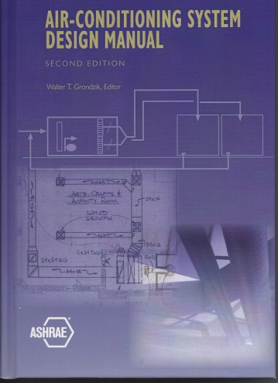
Task 1 – System Diagrams
Shared
The objective of this task is to indentify standard industry HVAC systems that can be used to define system level efficiency and metrics for a higher level approach to setting efficiency requirements as well as evaluating systems.
The systems should include all components used to condition and ventilate the space
Water Cooled Chiller
Air Cooled Chiller
Rooftop
Split System
WSHP
VRF

Slide 61

Task 2 – System Rating Map
Sections
The goal of this task is to develop the procedures for ratings of the complete system operating map to support simulation tools and system analysis
This task will work closely with the SPC committee developing the ASHRAE Standard 205
It is likely this will also require research to develop better correlations for modeling
Also security procedures defined by task 8
Complete Rating Map
Modeling Correlation Equations

Slide 62
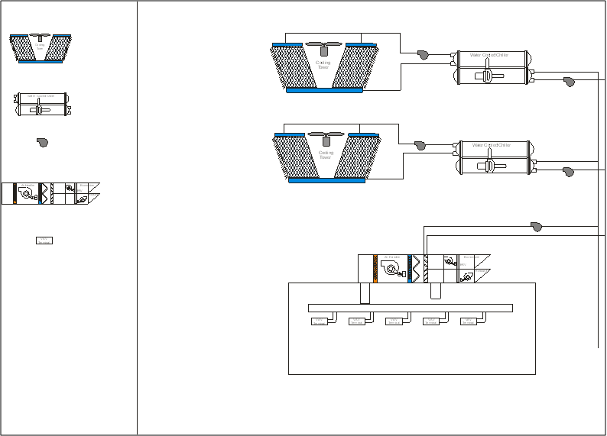
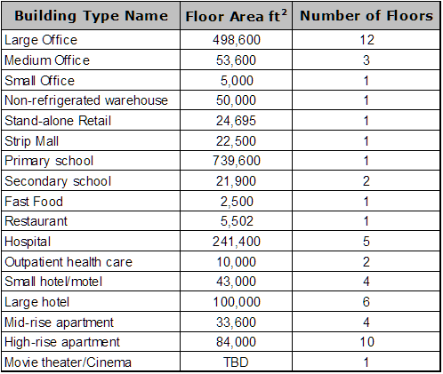
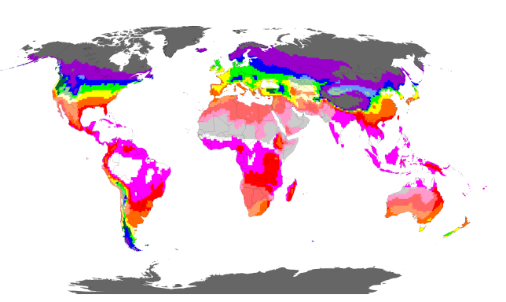
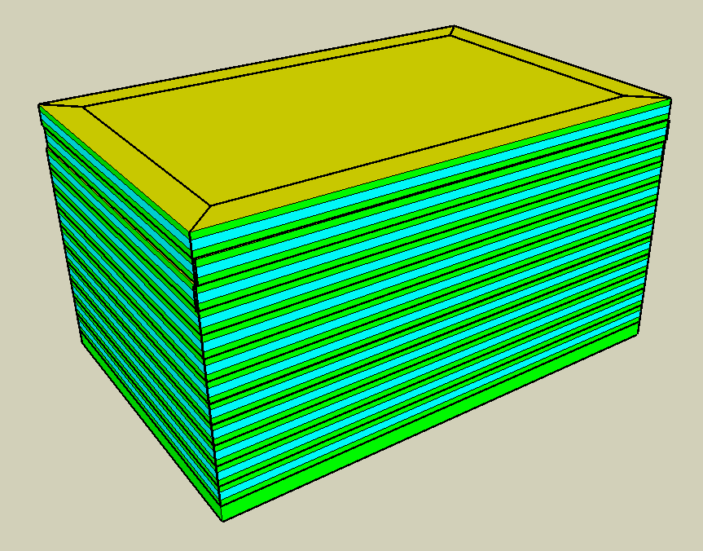
Task 3 – System Evaluation Tools
Systems Steering Committee
The concept for this task is to develop system rating and evaluation tools that can model the complete HVAC System to determine an annualized efficiency metric
The concept is to use ASHRAE 90.1 standardized buildings and all 19 climate zones to allow the full system to be analysis vs. a base minimum system
The software tool would be designed to be user friendly and use an Icon based method to allow the system to be configured using task 2 models
Software would be maintained and managed by AHRI
Icon Based Software Tool Interface
ASHRAE 90.1 Standard Buildings
ASHRAE 169 Climate Zones and ASHRAE 90.1 Representative Benchmark Cites

Slide 63
Task 4 – New Full and Part Load Metrics
Sections
This task would develop and modify efficiency metrics for full and part load
Effort should consider both cooling and heating and representative buildings and climate zones
With growing global efficiency initiatives the effort should also include consideration of global environmental conditions and requirements
Effort should also consider hybrid systems like rooftops with ERV, equipment with economizers, etc
Full Load Metrics
EER
COPC
COPH
COPHR
kW/Ton
SCOP
HSPF
FER
Part Load/Annualized Metrics
SEER
IEER
ICOP
IPLV
ISEER

Slide 64
Task 5 – New Research Projects
Shared
This task will focus on research that supports the systems approach and subsystems approach
It will not replace standard research that is sponsor and managed by the R&T committee
Possible research projects could include
New equipment models for equipment
New modeling techniques
Development of new part load metrics
Modeling tools
We currently have one research project started to Develop Fan Power Terminal Unit Performance Data for EnergyPlus and other simulation models

Slide 65
Task 6 – Section Organization and Collaboration
Shared
The current approach to sections, AHRI standards and certification programs has been based on the historical approach to develop standards and certification programs around a component prescriptive approach
As we move to a more systems approach it may be necessary for different sections to work together on a systems approach or to change or add new sections
There also may be synergies between different products with similar operating characteristics and full and part load metrics
It will be important for sections to work together and one concept may be to form super-sections that work together to develop a systems approach (i.e. Chiller Water Super Section)

Slide 66
Task 7 – Combined Ratings for Hybrid Systems
Sections
The intent of this task is to develop combined ratings for full load and part load for hybrid systems similar to the guideline V that is used for rooftops and ERV combined units.
The goal is not to require retesting of the combined units but instead using the individual unit ratings and combine them using the rating procedure.
The procedure can be defined in guidelines or new standards and may require computer tools to develop the combined ratings
The regional weather conditions will also have to be included in the metrics
A key enabler will likely be the system map ratings defined in task 2
Certified
Certified
Certified
Output
∑ inputs

Slide 67
Task 8 - Electronic Transfer of Ratings Maps
Systems Steering Committee
The goal of this task is to provide a standardized method for the decimation and transfer of rating maps for products and components that can be used directly in system model tools like EnergyPlus and tools that this Systems Steering Committee may develop.
These rating maps are not just the full load ratings. These are ratings that cover the full operating map of the product and both full and part load at a diverse set of operating and ambient conditions.
This task will come up with standardized electronic data transfer methods to pass these ratings to equipment models. Work is already underway in ASHRAE 205 to develop standard formats, but they are struggling due to a lack of understanding of the equipment.
The goal is to develop electronic methods to transfer this data while maintaining the intellectual property of the manufacturers.
This effort will also have to work closely with Task 3 involving system modeling and Task 2 for the development of these maps.

Slide 68
Task 9 – Products and Certification
Shared
This task will look at the existing AHRI standards and certification programs, then review equipment currently in use.
Should any additional equipment be covered under AHRI standards?
This could require the addition of new Sections and Engineering committees or restructuring of existing sections.
It also could involve collaborative efforts between section
Secondary task will be to review standards versus certification programs to see if more products require a certification program to drive for higher system efficiency.
As part of this we should also consider global implications

Slide 69
Task 10 - Smart Grid
Other
The objective of this task is to develop recommendations and best practices for commercial equipment to interface with the new emerging Smart Grid
This can include interface to control peak power, but also can include interface that enable diagnostics and prognostics
It can also be used for building management and smart dashboards for monitoring building energy use
The effort should include standard work definitions for protocols and other communications interfaces
A committee has already been formed to do this for residential products and the thought is that we would leverage this effort thru the same working group or a commercial subgroup under the overall Smart Grid effort
DOE recently in a meeting indicated that they have a strong desire to be involved in the development of the Smart Grid and they should be involved in the effort that will be done under this task.
It looks like the Smart Grid could have a lot more capabilities other then just demand limiting

Slide 70
Task 11 – Retrofit Strategies
Sections
Today 60% to 80% of the HVAC units that are shipped are for retrofit applications but typically this is done when the unit has failed and then just the unit is replaced.
With the significant increases in efficiency since 2010 which are in the 30% range it often can make sense to replace a unit before it fails. This also could factor into refrigerant phase down regulations.
When a unit is replaced it also is an opportunity to relook at the overall system and make further improvements to improve the overall system
This task would involve develop white papers and guidelines that could show the benefits of early replacement (before failure) and also upgrading the system with state of the art systems approaches for features like economizers, demand ventilation, energy recovery, controls and other technologies that our member have developed.
The tasks could also develop tools that would assist in the energy and economic analysis
The task will also explore the offer of incentives by government agencies and utility companies

Slide 71
Task 12 – Building Controls and Interface
Systems Steering Committee
It is becoming common practice for medium to larger size buildings to have overall building control systems and even small buildings typically will have one or more smart thermostats depending on the number of HVAC systems
Today there is not common communications format or protocol or standardized control logic
Some work has been started in ASHRAE Guideline 36P to develop standardized control logic and some common interface protocols like BacNet (ASHRAE Standard 135 )
There are some dashboards that have been developed which make it easy to monitor and display the operation and energy use of building, but there are not standards
Some standards like ASHRAE 90.1 and ASHRAE 189.1 are now starting to include requirements for DDC control and building controls
This task would involve developing guidelines for interface with building
Most of the work would have to be done by the Systems Steering Committee or a subgroup of experts as this is not something we could pass to the sections. Section input will be required for review
It also could tie into task 11 and the Smart Grid
This task can also be an important enabler for diagnostics and prognostics (task 14)

Slide 72
Task 13 – Application and Maintenance
Sections
The objective of this task would be to develop standardized procedures and guidelines for the proper commissioning, re-commissioning and maintenance of products and systems.
This can be done at the HVAC unit level or at a full system level.
Most of the work should likely be done by the sections and their Engineering committees, but should reference work done by ASHRAE in standards like ASHRAE 180
It also will be important for this task to interface with task 14 covering diagnostics and prognostics as well as task 12 for controls interface
A task that could also be beneficial is to develop some cost benefit analysis tool showing what proper maintenance can do
Also would be desirable to work with Standards group like ASHRAE 90.1 that currently do not have any requirements for proper commissioning and maintenance and ASHRAE 189.1 which has some limited requirements
As noted early the audits of equipment in the field are showing this is a huge opportunity to reduce energy use

Slide 73
Task 14 – Diagnostics and Prognostics
Shared
The goal of this task would be to develop common requirements for diagnostics and prognostics for HVAC equipment and HVAC systems
It would create guidelines and/or standards
It also could develop certification programs and test procedures for qualification of diagnostics routines and diagnostic hardware that is added to HVAC equipment.
Work is already underway in ASHRAE Standard 207P that AHRI really should be involved in as part of this task.
This could be done by a separate working group, or by sections or system sections (“super sections”)
There are also industry consortiums and alliances that the effort should interface with like the Western Cooling Center Alliance
This task could also go further and develop industry standard diagnostic routines thru third party research groups like Purdue or the Penn State Hub.

Slide 74
Task 15 – Codes and Standards
Systems Steering Committee
This task is actual divided into three parts
Others (i.e. proposed legislative structure)?
15b. Prepare and obtain legislative assurance that DOE (EPA?) must pursue systems efficiency and discontinue pressing for higher equipment prescriptive efficiencies.
15c. Create a code language document that unambiguously describes the means to determine system cost effectiveness from a known baseline.
They goals of this task are to:
Create a code language document that unambiguously describes the means to determine system cost effectiveness from a known baseline. (15c)
Develop the legislative structure necessary for the transition from continuous minimum equipment efficiency increases to a “Systems Efficiency” requirement.
Prepare a legislative document that assures that DOE and EPA must pursue systems efficiency and discontinue pressing for higher equipment efficiencies, including a state preemption from exemption from the requirements. (15b)

Slide 75
Task 16 - Communications
Systems Steering Committee
To accomplish the overall systems goals and approach, change will be required to AHRI procedures, ASHRAE 90.1 and other ratings standards as well as federal laws defining the approach that is to be used for equipment and building efficiency
Communications will be extremely important the accomplish the tasks and the overall goal.
This effort will use the existing AHRI committees like the Unitary Regulatory Committee and the Government Affairs committee as well as a new external firm that AHRI has hired for communications and the development of a “Thought Leadership Plan”.
Work has already been underway on this and the concept of a systems approach has been shared with the industry and has received strong support

Slide 76
Requested Action for the AHRI Sections

Slide 77
Section Action Plan – Strategic Plan
The Systems Steering Committee is requesting that the AHRI sections take the requested section tasks and begin the development of a “Strategic Plan” that will address the tasks that they feel are appropriate to their section
The primary focus in on commercial products and systems but some of the actions may also be appropriate for residential products and systems.
Some sections have already created a Strategic Plan for other activities and have found that it can be a useful tool to map out where they want to go with product coverage, ratings, and certification
We would like to have a copy of the plan completed by no later than Oct 1, 2014 so that the Systems Steering Committee can review and update AHRI at the fall meeting

Slide 78
Strategic Plan
The following should be consider in the development of your section strategic plan
Begin the development of part load metrics if your products do not currently have one, or expand the use of part load and annualized metrics for cooling and heating operation for products and subsystems. Metrics should consider climate and regional impacts as well as building type impacts where practical
Begin to develop guidelines for subsystem combination ratings similar to AHRI guideline V but for other subsystem attributes like economizers, evaporative cooling, etc. This may require formation of collaborative section working groups where multiple section products are used to make a complete HVAC systems.
Begin the development of strategies and procedures to rate and certify the complete operating map for equipment to enable modeling and transition from a multiple prescriptive ratings method to ratings based on certified prediction tools
Develop guidelines for best practices for commission and maintenance of HVAC equipment as well as tools and guidelines for replacement and upgrade of systems
Sections may also want to add other strategic initiatives to their plans as appropriate

Slide 79
Questions & Discussion

