Slide 1

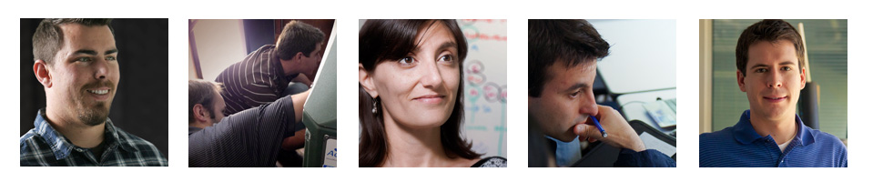
Current and Future Activity Highlights
Mark Modera
WCEC Affiliates Forum
May 20, 2014

Slide 2
Existing Project Highlights
Aerosol Sealing
Multiple new contracts and proposals
Big successes in Honda house and in New York City apartments
RTU Retrofit
ASHRAE Standard Committee 212 launched
First data obtained in the new climatic chamber

Slide 3
Aerosol Envelope Sealing Honda House (Pre-Sheetrock)

Slide 4
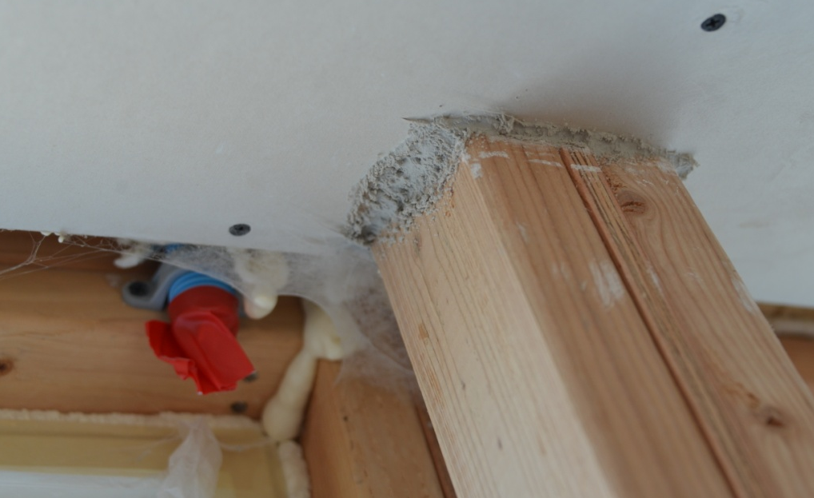
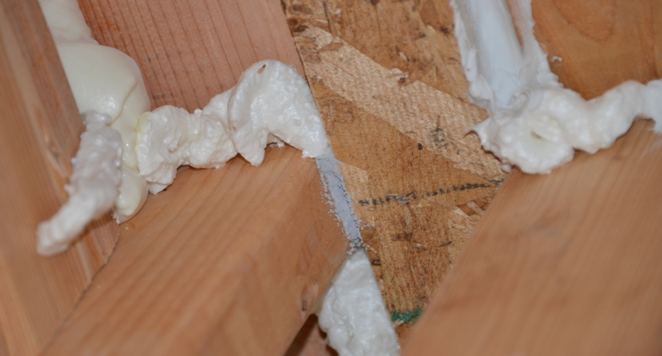
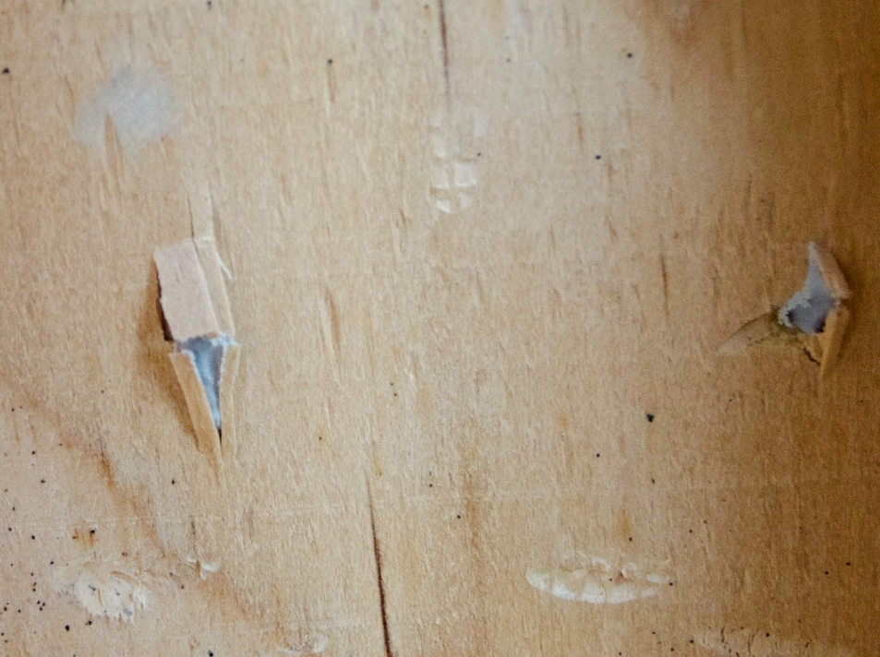
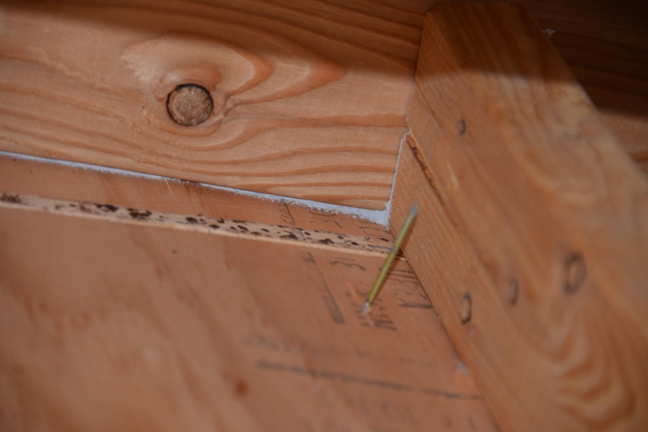
Aerosol Envelope Sealing

Slide 5
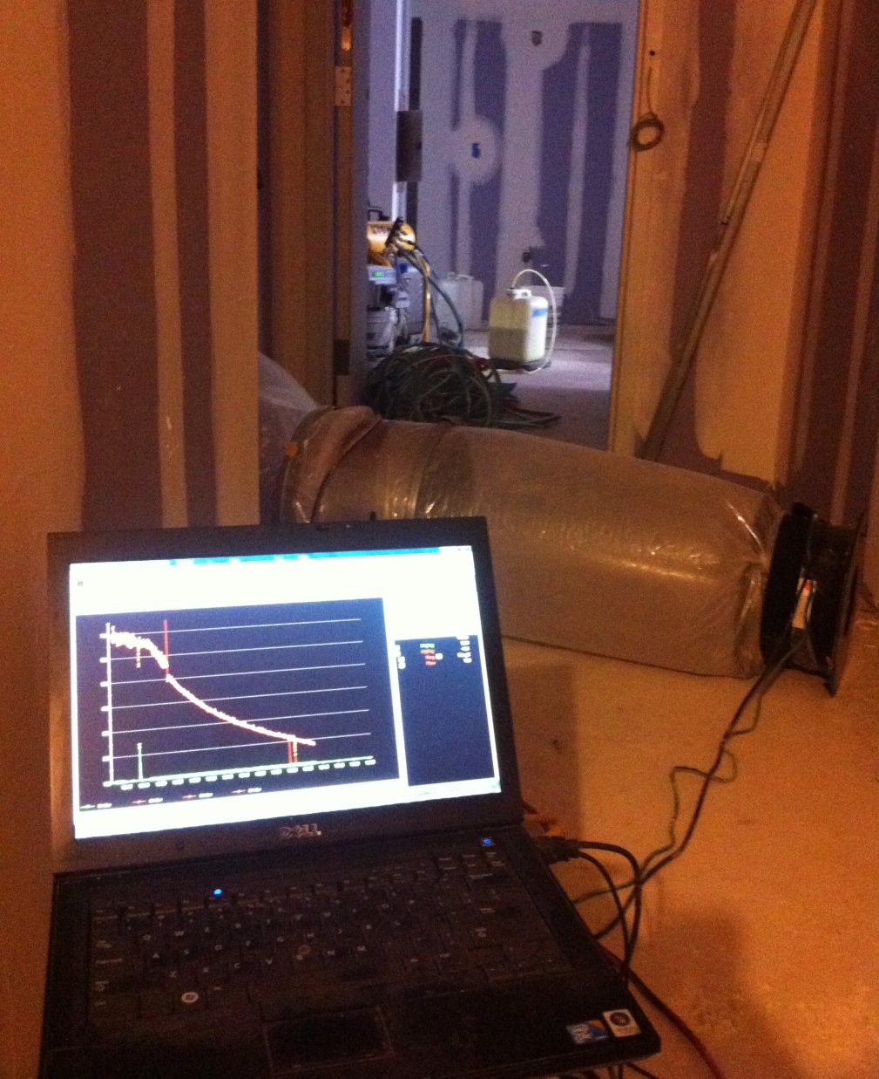
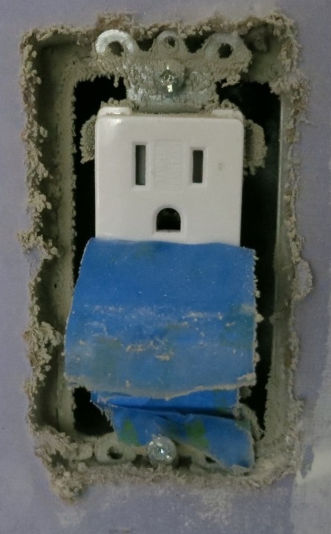
New York City Apartment Sealing
4 apartments sealed (~80%)
1-2 hours of injection (1-2 ach50)
Sound transmission measured
Fluorescence only when wet
Clear impact of humidity on process and seals

Slide 6
Comparison of Injection and Sealing Rates

Slide 7

Aerosol Envelope Sealing - Nozzle Testing
Characterize aerosols at different operating conditions
Determine optimal particle size and humidity for aerosol envelope sealing (and gas pipeline sealing)
Support with CFD analysis of particle drying process
Layflat Duct
14” Rigid Duct
Flow of ambient air
Damper for pressure control
Cascade Impactor
T, RH of ambient air
Flow of compressed air
P, T of compressed air

Slide 8
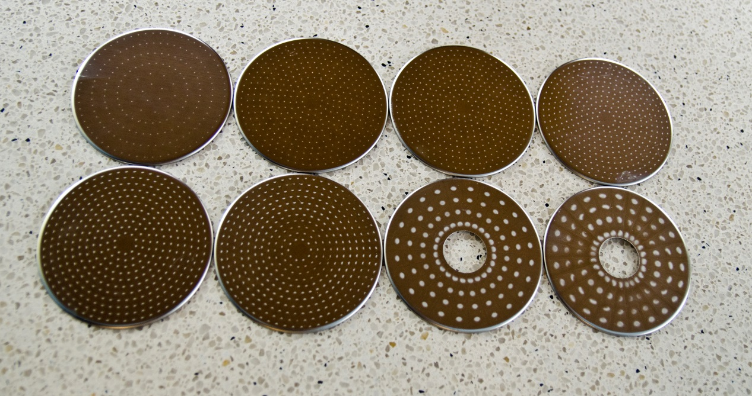
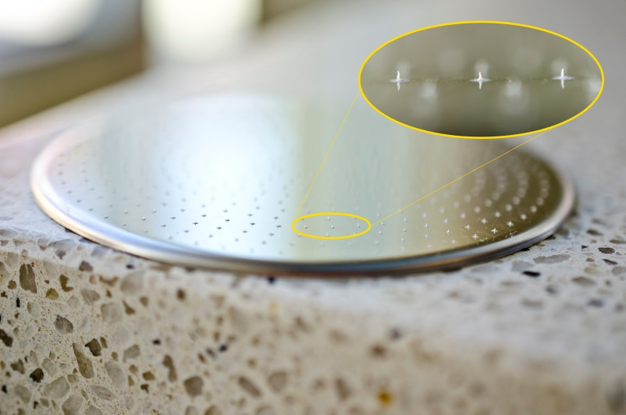

Preliminary Tests

Slide 9
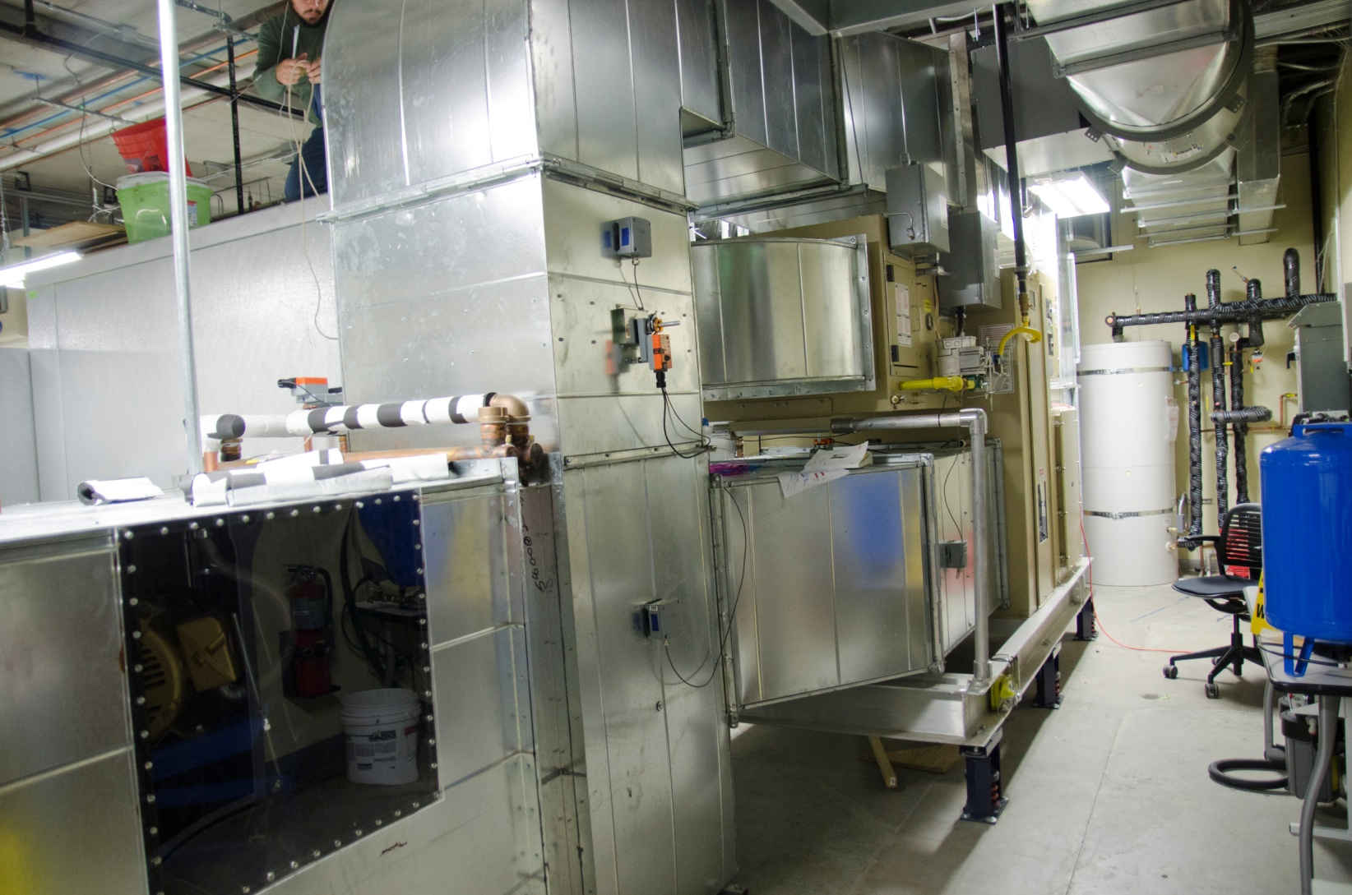
RTU Retrofit - WCEC Environmental Chamber

Slide 10
WCEC Chamber Capabilities
“Hot” Side Chamber
Temp/humidity control to wide range of climate conditions. Dehumidification for testing evaporative cooling equipment.
Airflows up to:
5000cfm (all climate conditions)
8000cfm (limited climate conditions)
Airflow measurement per ASHRAE 41.2
High-accuracy chilled mirror dew-point and temperature measurements on inlet and outlet
“Cold” Side Chamber
Heating/humidification sized for cooling equipment up to 5 tons
Airflows up to 3500 cfm
Airflow measurement per ASHRAE 41.2
High-accuracy chilled mirror dew-point and temperature measurements on inlet and outlet
Can reproduce hot, dry CA climate conditions regardless of Davis weather

Slide 11
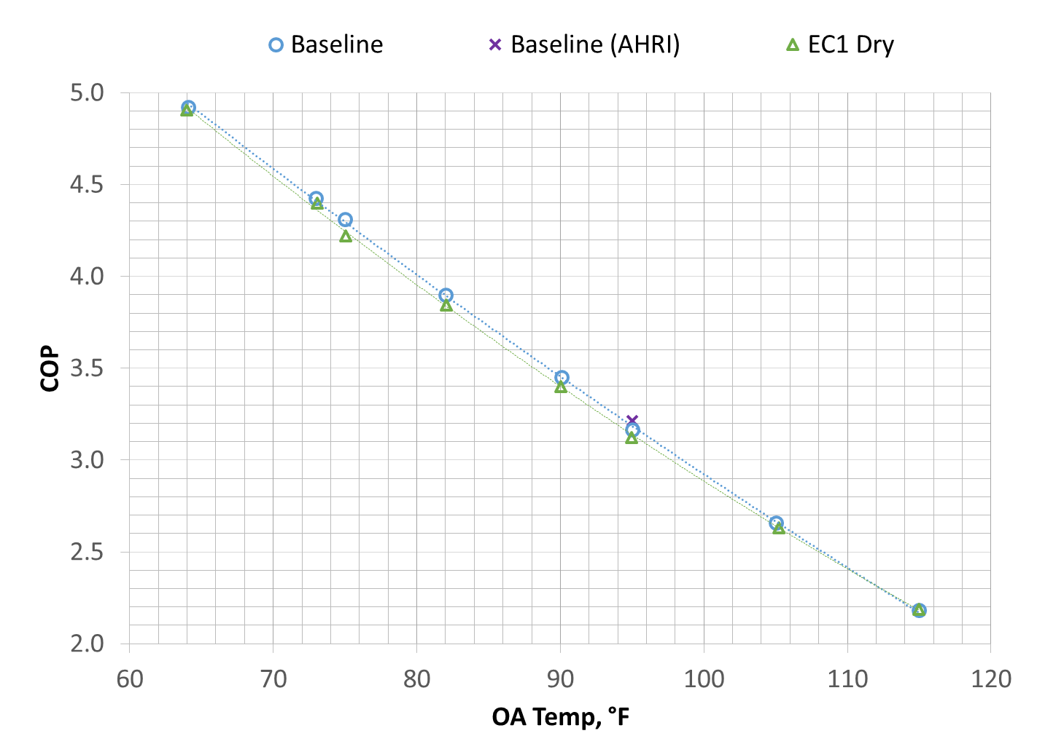
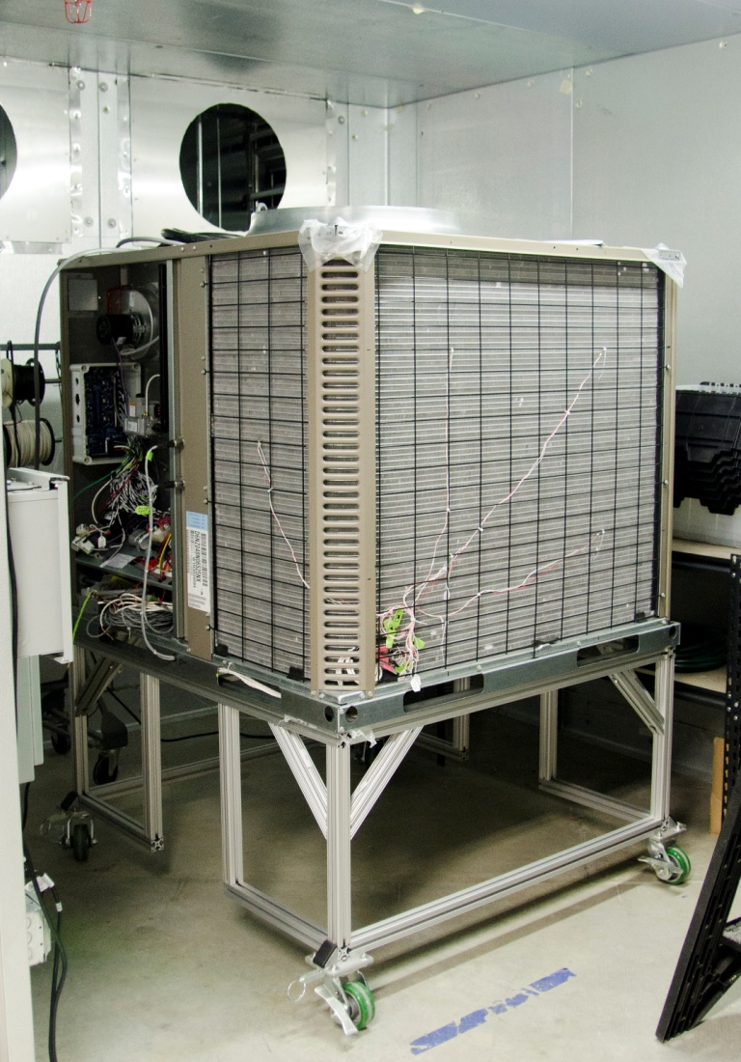
RTU Retrofit Project
Baseline and testing of first pre-cooler in “dry” mode completed April 2014
“Wet” pre-cooler testing to follow
Baseline shows excellent agreement with AHRI

Slide 12
Existing Project Highlights
Occupancy-Responsive Adaptive Thermostats for University Residence Halls
SPEED Project

Slide 13
Occupancy-Responsive Adaptive Thermostats for University Residence Halls
Improved control and facilities management
Excellent on-board algorithms
Can achieve substantial savings (20% or more, but not always)
Savings is sensitive to application, climate, occupancy patterns
Thermostat needs to have full control over space to achieve savings
Interactive effects between rooms diminish savings
HVAC sequence of operations can essentially void control
Recommended simple tests to determine if a building will achieve savings
Simple models tend to over-predict savings

Slide 14
Academic Period Indicated No Savings

Slide 15
Non-Academic (Summer) Shows 20% Savings

Slide 16
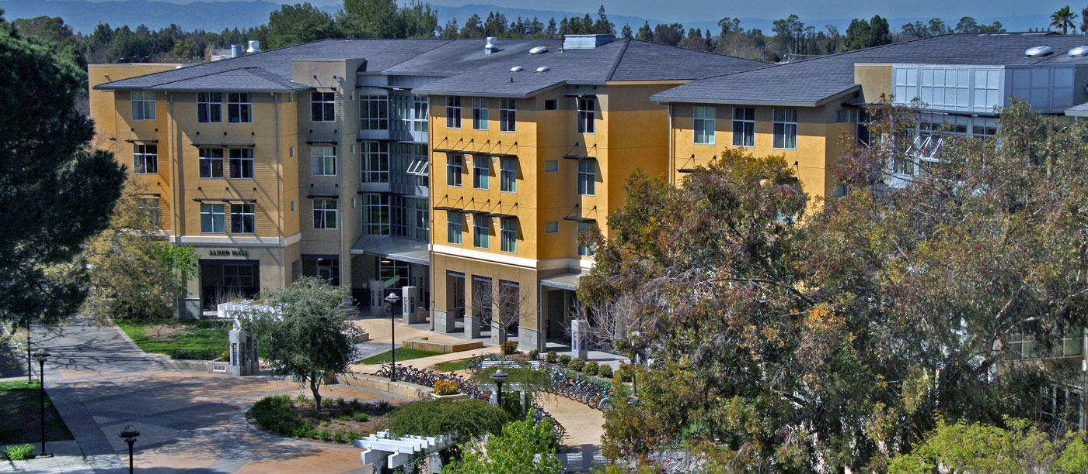
Occupancy Sensing Adaptive Thermostats for University Residence Halls

Slide 17
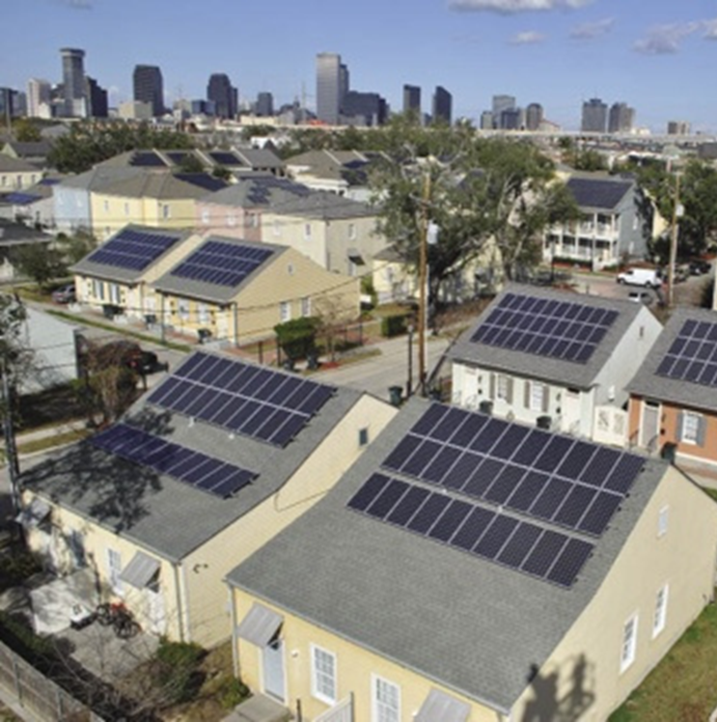
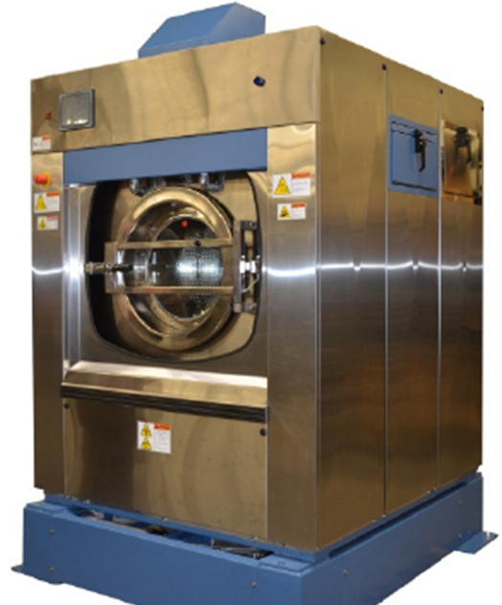
New Projects
Smart Power for Solar Homes
Collaboration with UC Irvine
HVAC solutions and battery storage to optimize peak shifting
Polymer Bead Laundry
Side by side comparison with “typical” small commercial washing machine at Capital Athletic Club
Tracer Gas Air Flow Measurement
Commercialization funded by UCOP
Filed provisional patent

Slide 18
Commercialization of Tracer Gas Airflow Measurement Tools
Packaged flexible tool, software, and methods for field measurement of air flow
High accuracy: ~1.5% uncertainty up to 10,000 cfm
Large dynamic range: 50 – 50,000 cfm
Uses industrial CO₂
Field Testing Generation 1.1 prototype
Developing Generation 1.2 to cut cost by 50%

Slide 19
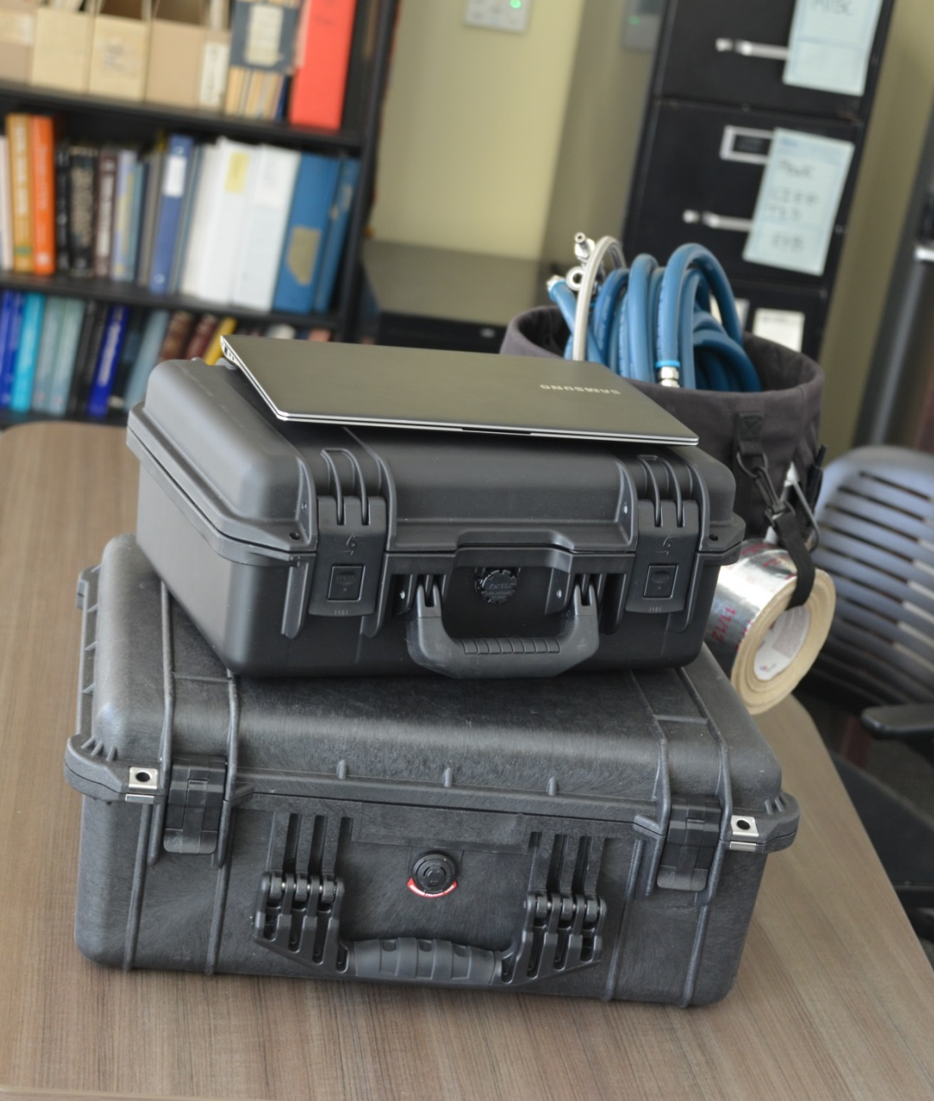
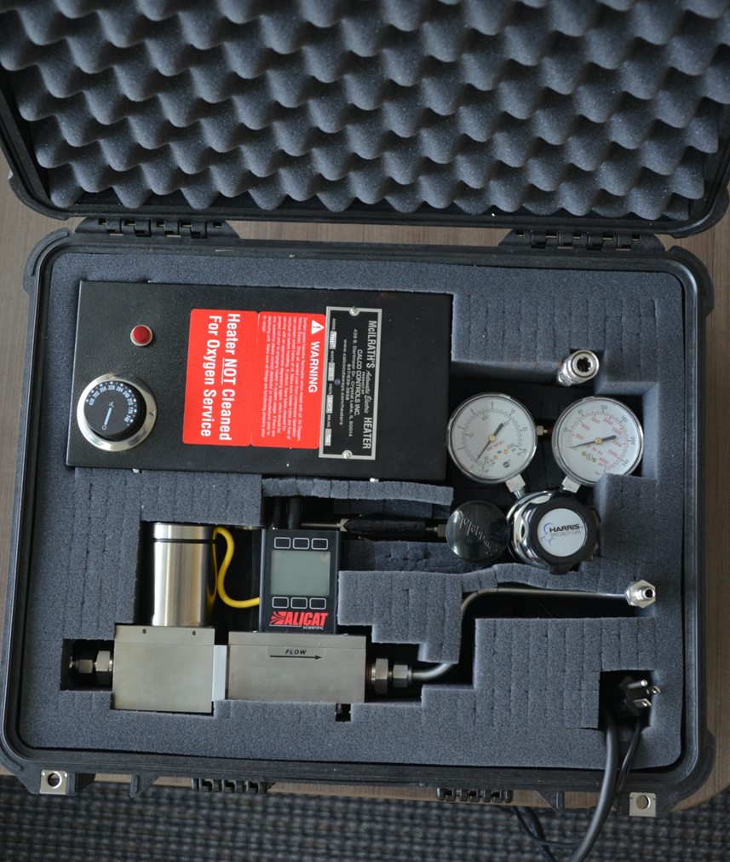
Tracer Gas Airflow Measurement

Slide 20
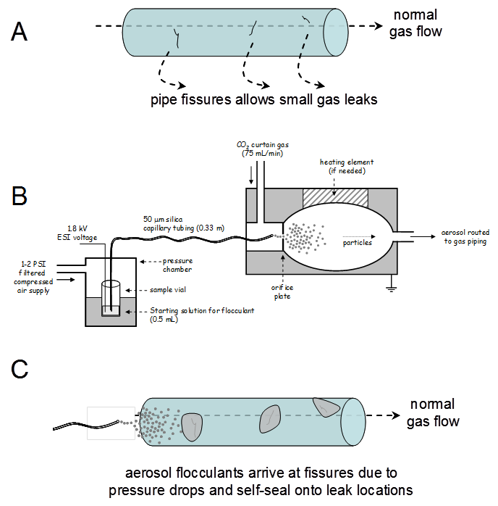
New Projects
Natural Gas Pipeline Sealing
Contract in place with CEC EISG
Pending with Scotia Gas in the UK
Met with Fossil Fuels office at DOE
Open-Source Building Automation System
Thermostats and RTUs
Integration with lighting and plug load controls
Gateway for FDD and Climate Appropriate RTUs

Slide 21
Future Projects – Proposals in Process
Ventilation in Schools (CEC)
CO₂ and outdoor-air balancing act
Large Building Aerosol Sealing (DOD ESTCP)
Army Corps of Engineers leakage specification
Sub Wet-bulb Evaporative Chilling + Solar Thermal Heating (DOD ESTCP)
RTU Solution for Energy Efficiency Using Free Cooling (DOD ESTCP)
Natural Gas Dryer Controls (CEC EISG)
End of cycle control

Slide 22
Future Projects – Proposals in Process
Integrated Appliances (BPA)
Combined heating, cooling, DHW appliances
Water Chemistry (BPA/SCE)
Water sourcing/management for evaporative cooling
Non-chemical water treatment
Heat-pump water heaters

Slide 23
Future Projects – Proposals in Process
VRF plus DOAS (CEC EPIC)
Building-level solutions
Residential HVAC Performance (CEC EPIC)
Passive HVAC, Thermostats, FDD, Contractors
Cloud-Based Refrigeration Control (CEC EPIC)
Collaboration with UC Davis Food Science and Industry
Micro-Channel Absorption Chiller (CEC EPIC)
Collaboration w/ industry

Slide 24
Future Projects – Proposals in Process
Variable-Capacity Residential Heat Pump (CEC EPIC)
Full-range performance testing
System efficiency (including ducts)
Residential Thermostats (CEC EPIC)
Low-income thermostat usability

Slide 25
THANK YOU!
For more information, contact us at…
http://wcec.ucdavis.edu

